Slide 1


Smooth Operator
Move anything, anywhere, anytime
Celine Chen, Eric Chen, Jacob Chin, Nicholas Nguyen, Christian So
Team 30 CDR Presentation
Notes:
Jacob

Slide 2

In fast-paced environments requiring hospitality such as airports and hotels, there is a decline in service workers in the U.S. For those with mobility impairments, moving luggage and heavy objects can be a strenuous and daunting task.
Problem Statement
SmoothOperator

Slide 3
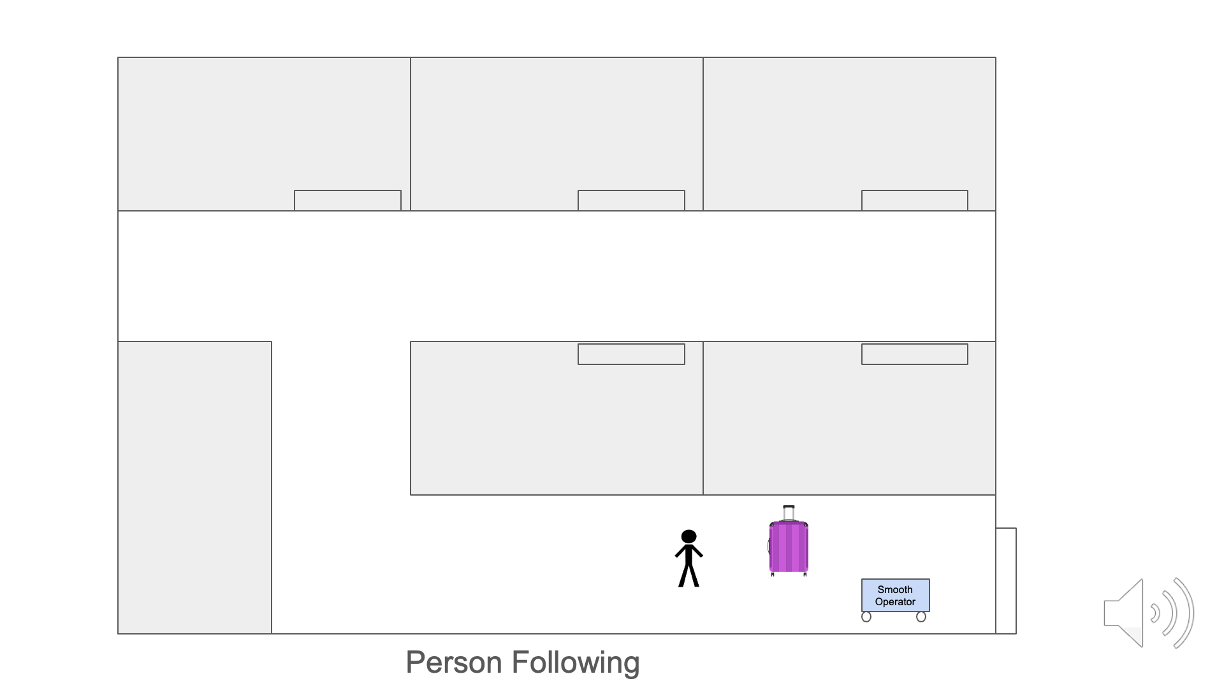
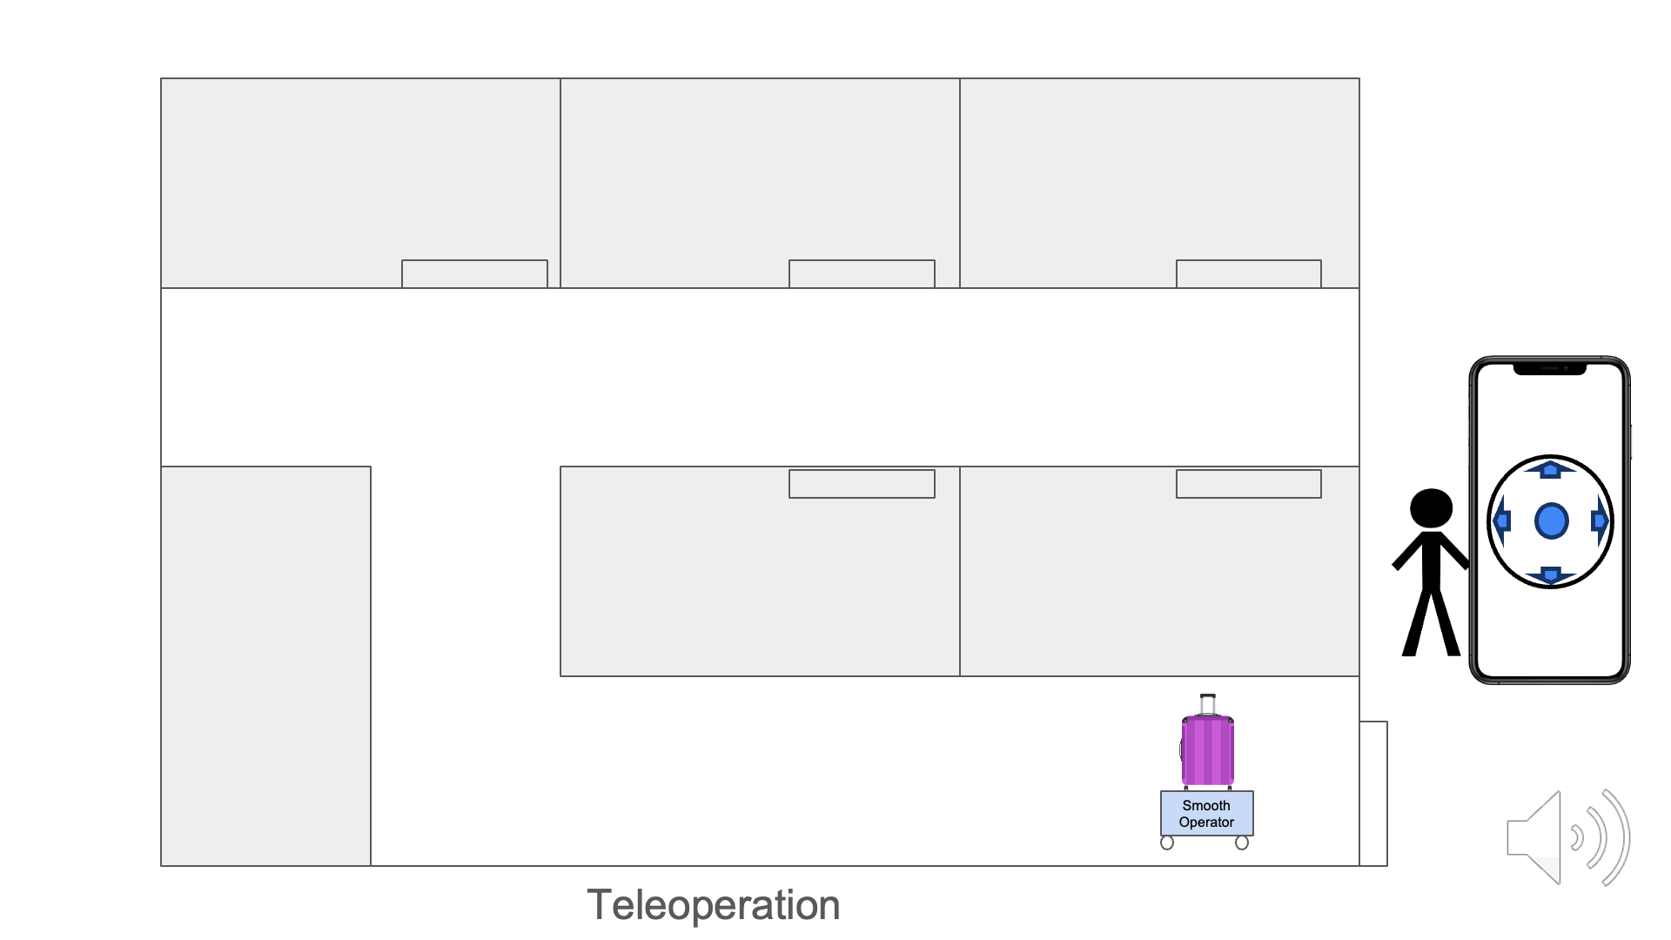
SmoothOperator
Enhance the quality of life by facilitating easy and
safe movement of objects
Our Solution
Roboticized Dolly
Facilitates easy & safe movement of objects
Adaptable to many environments
Semi-autonomous navigation & obstacle avoidance
User-friendly app to connect to robot
SmoothOperator

Slide 4
Overall System Design
SmoothOperator
Notes:
Christian

Slide 5
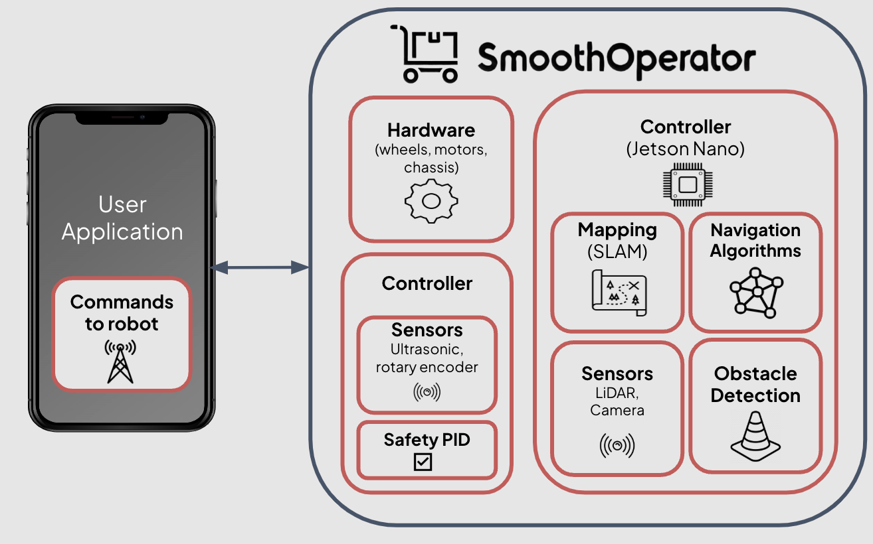
System Design
Team Distribution:
Mechanical Hardware
Electronic Hardware
Network & Teleoperated UI
Mapping & Navigation
Safety Design
Notes:
Christian

Slide 6
Mechanical Hardware
SmoothOperator
Notes:
Christian

Slide 7
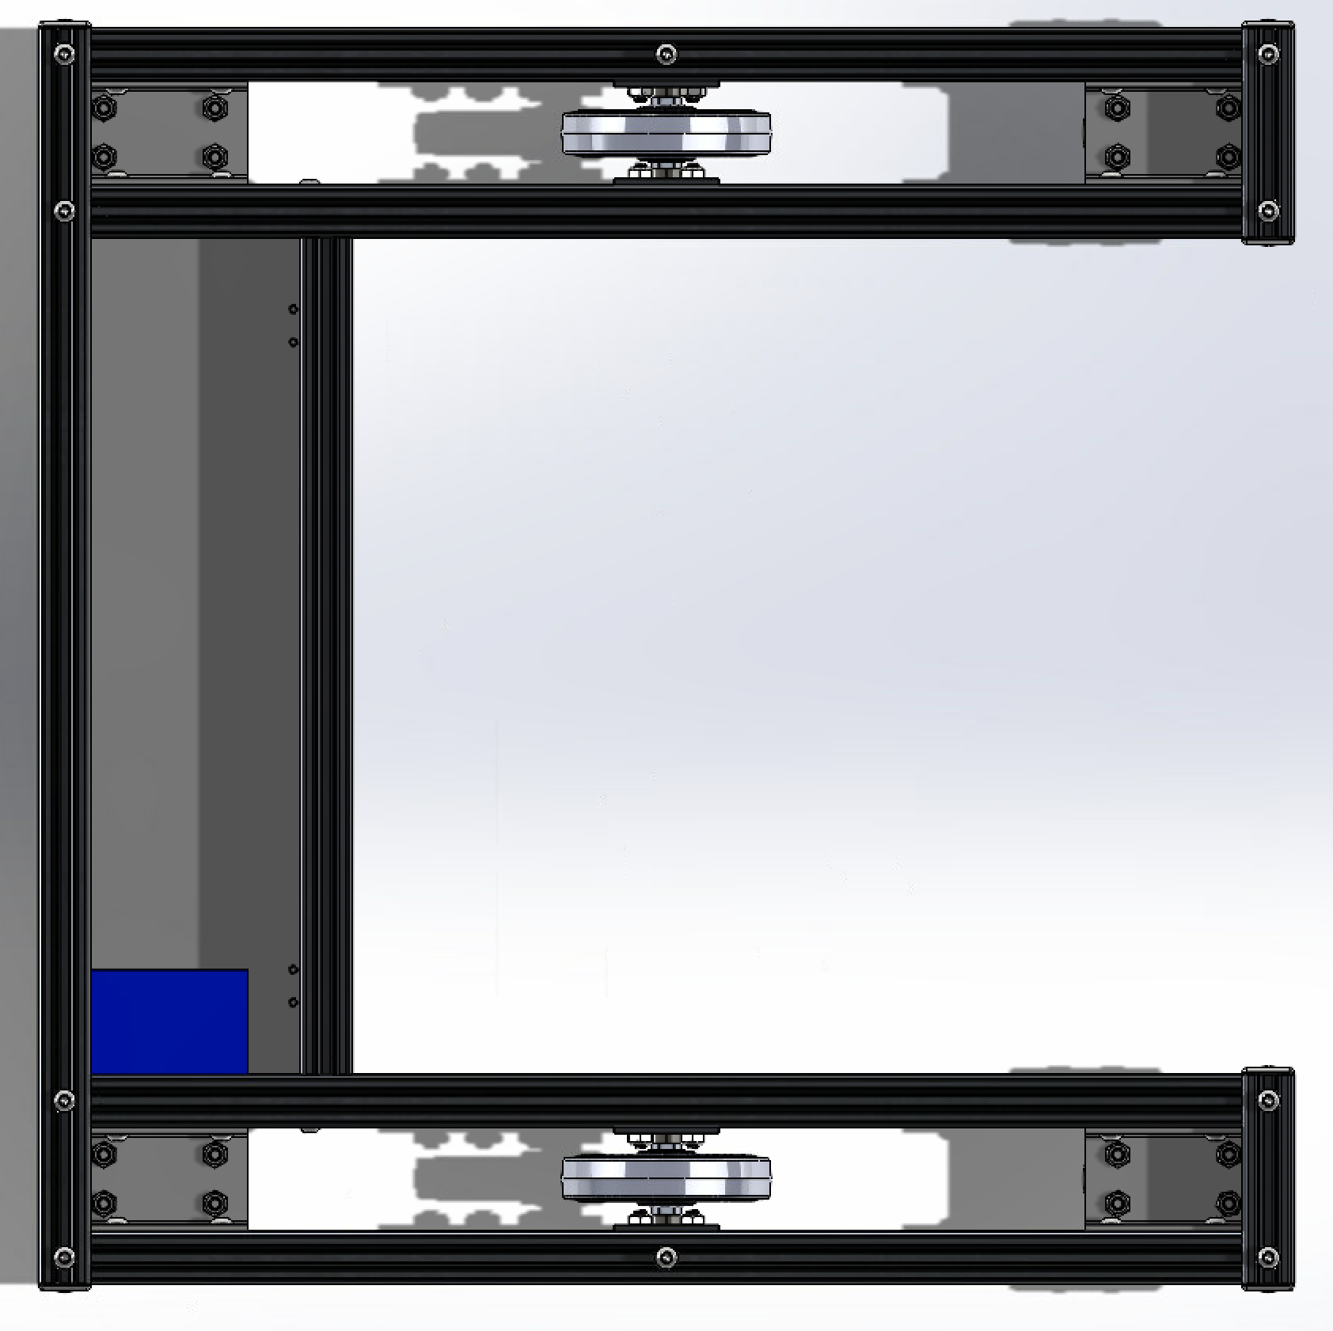
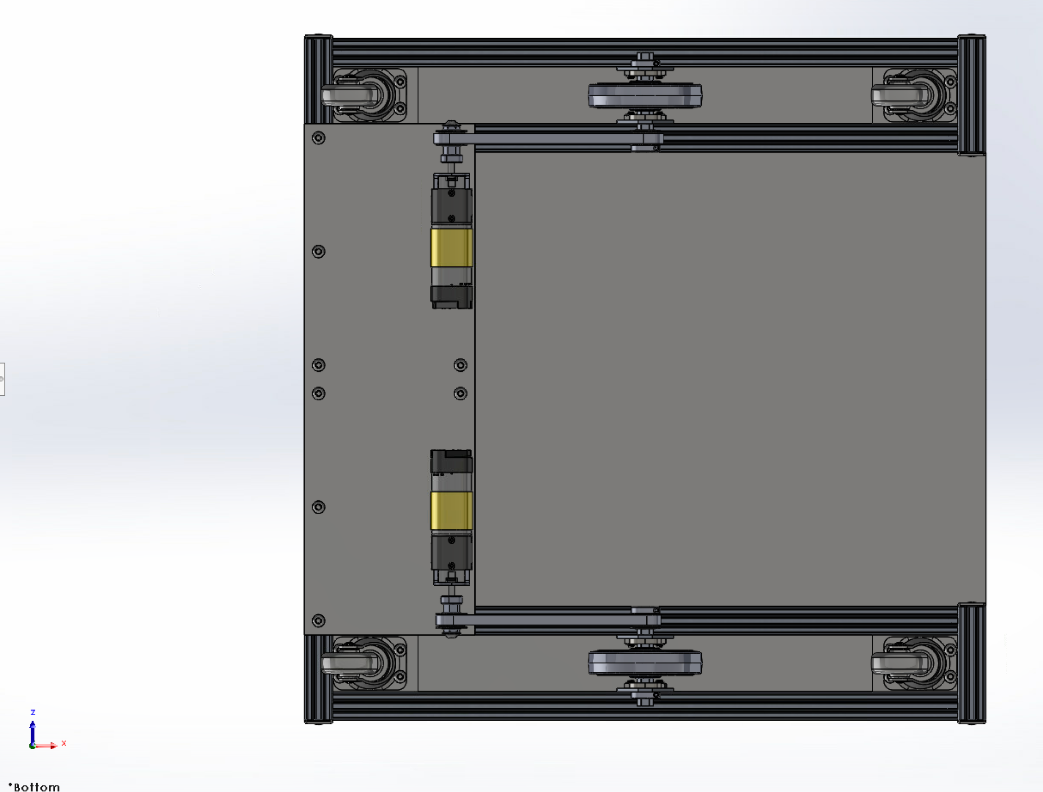
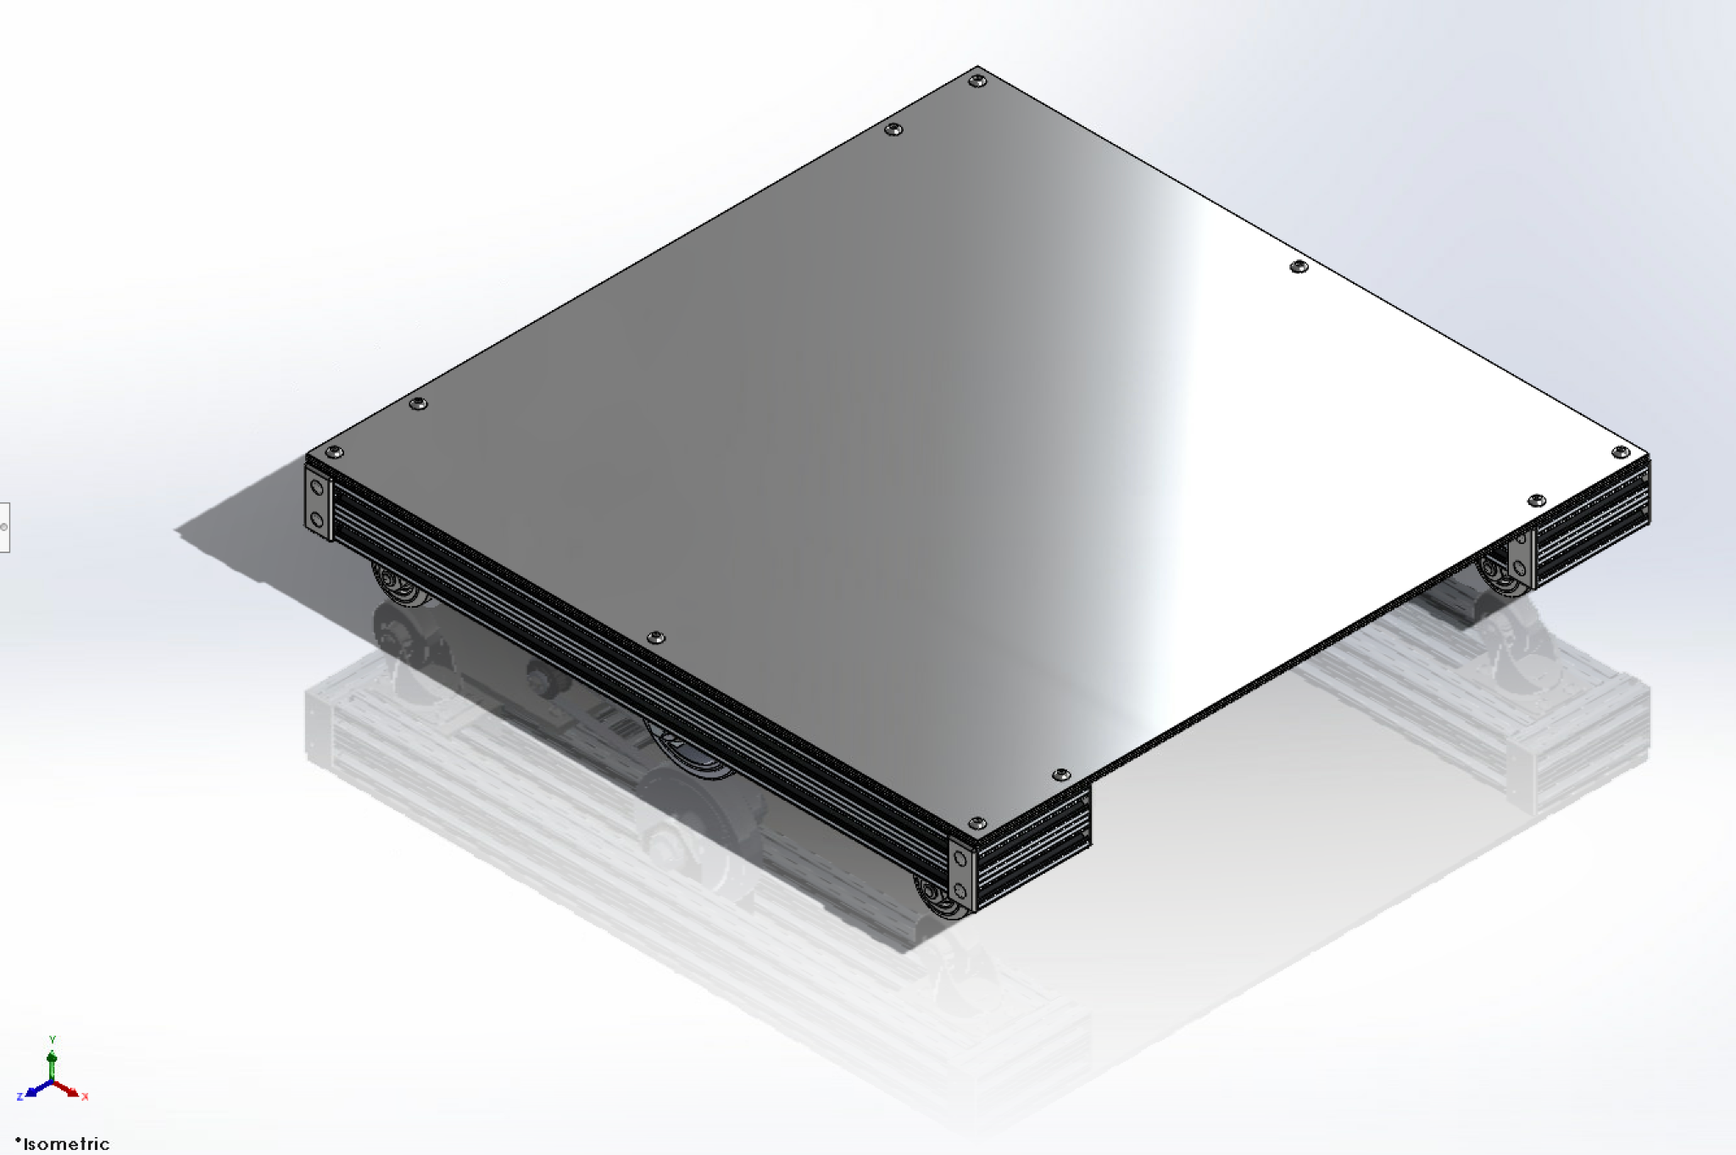
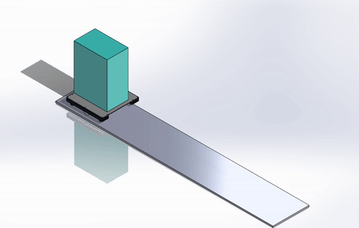
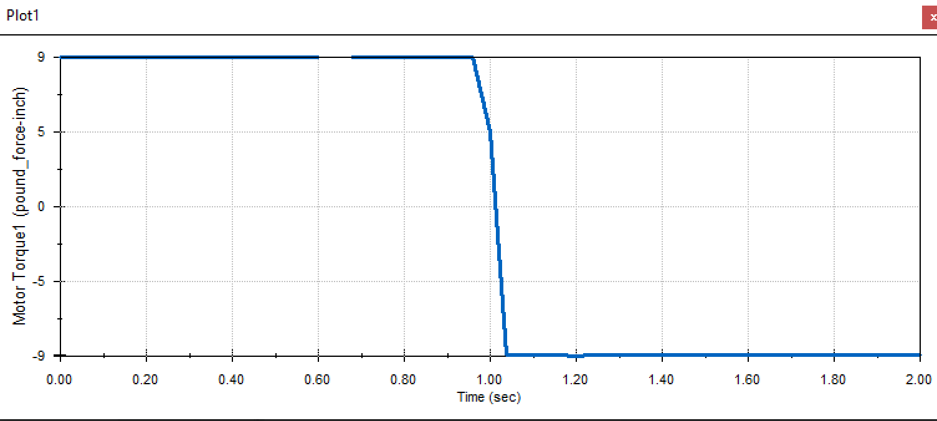
Chassis CAD
Top View
(removed top plate)
Bottom View
Isometric View
Simulation
Motor torque Curve (100lb)
Notes:
Nicholas
Add motor curve analysis from last semester

Slide 8
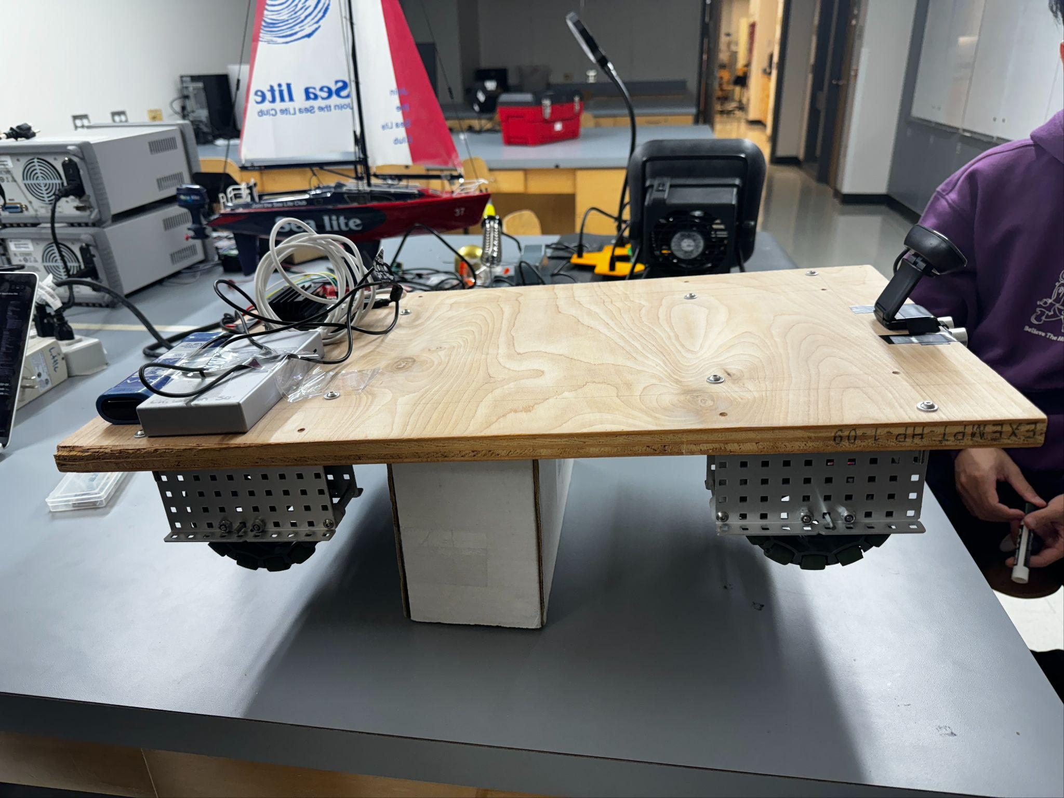
V0 Build
Made out of wooden board and VEX Robotics Pieces
Notes:
Nicholas
Add motor curve analysis from last semester

Slide 9
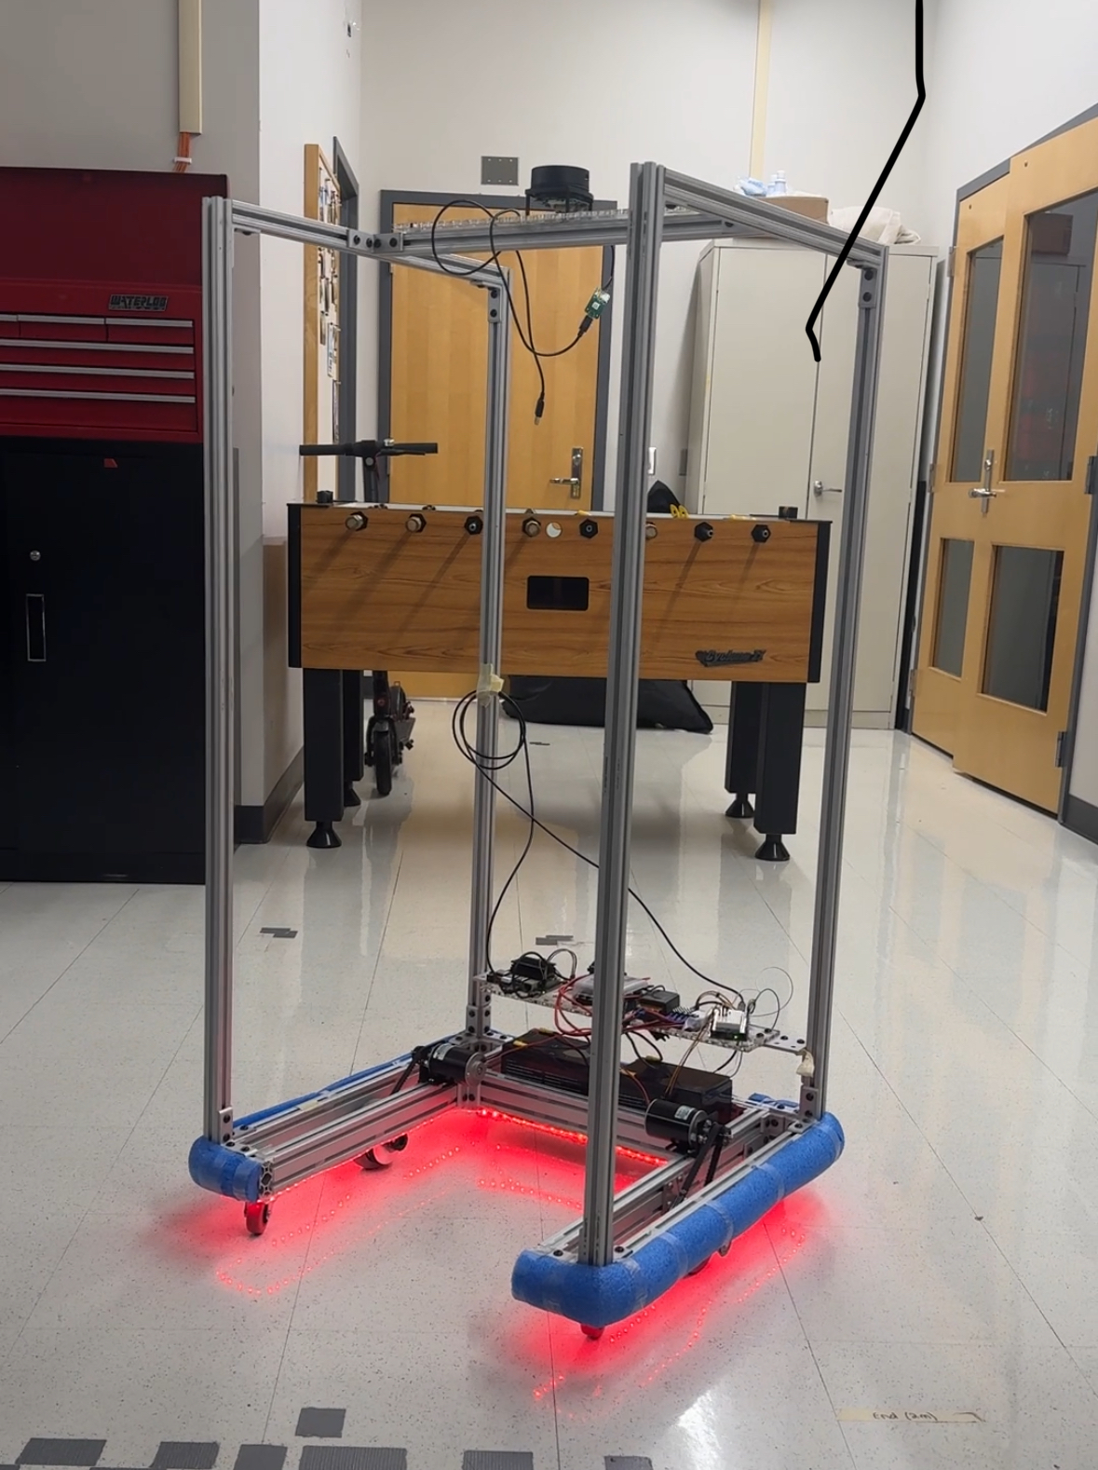
V1 Build (Current)
Build Discussed in Next Slides
Notes:
Nicholas
Add motor curve analysis from last semester

Slide 10
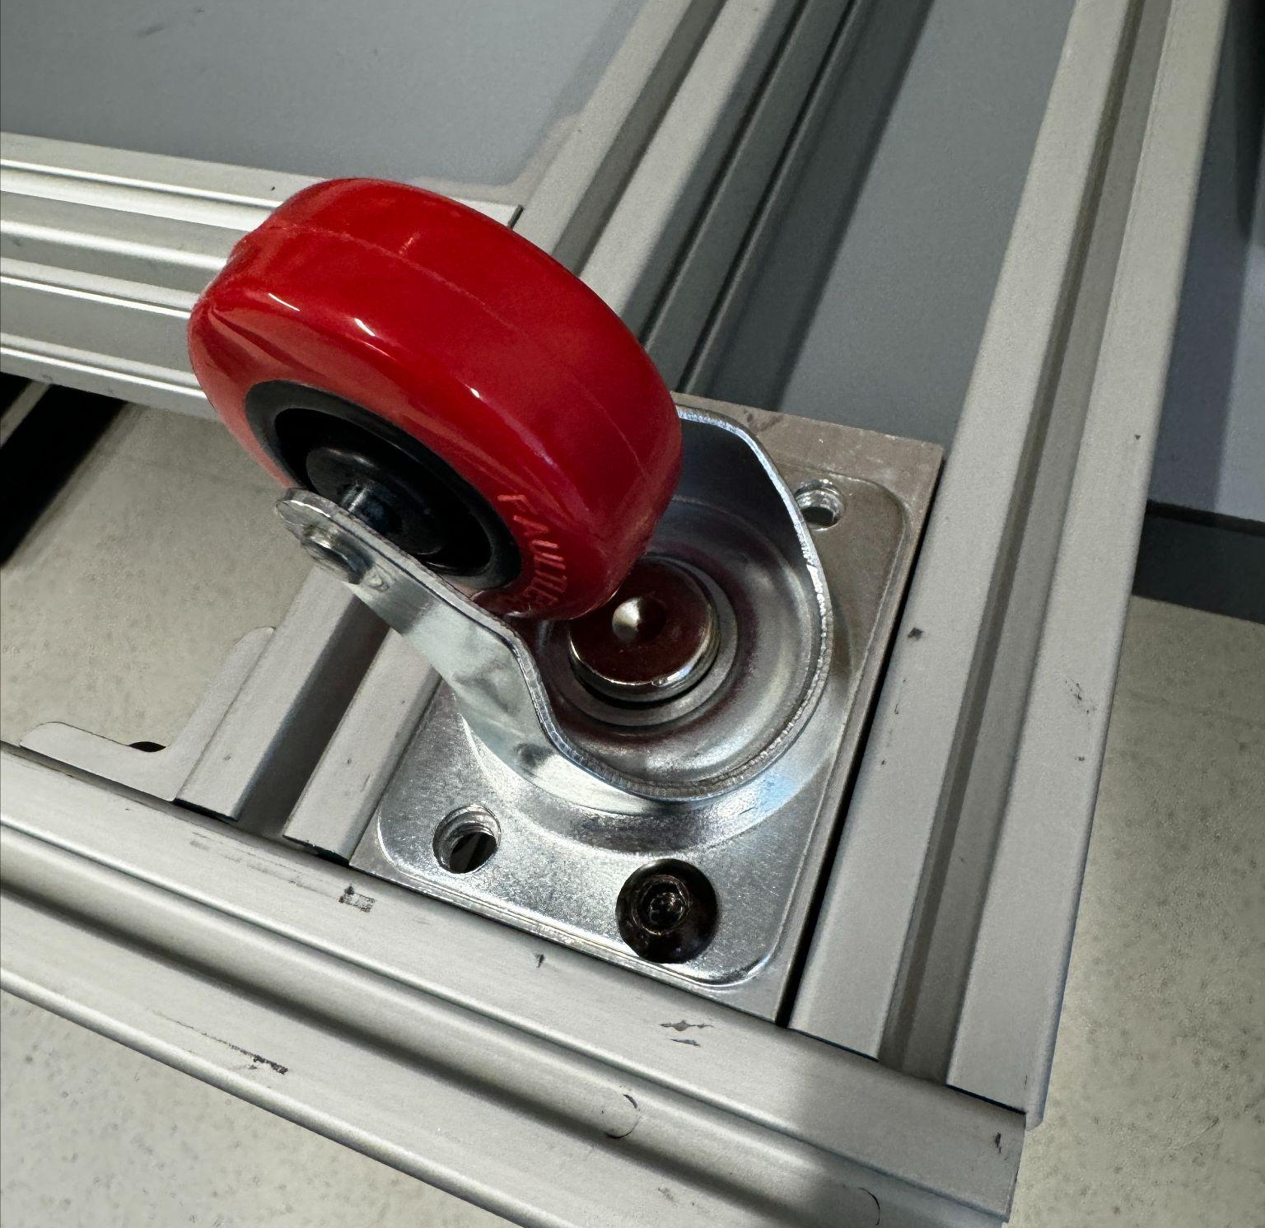
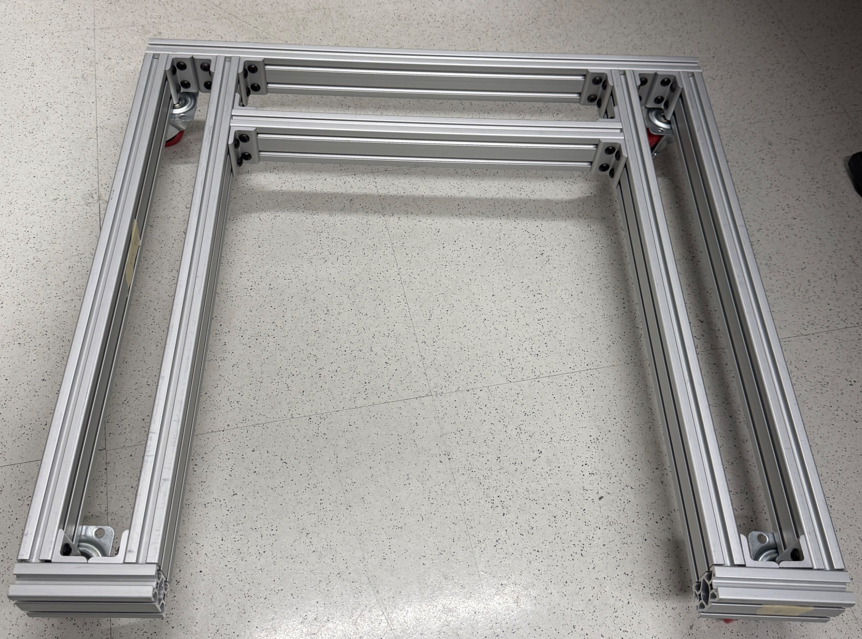
Chassis Development
Manufactured chassis
80-20 T-Slotted Aluminum Extrusions
Chop saw 80-20 aluminium to desired lengths
Tapped aluminum with ¼”-20 threads at ends for attachment
Caster wheels
Four 2” diameter polyurethane wheels mounted at corners
Mounting brackets machined from aluminum U-channel
4’ tall chassis for visibility from afar
Pool noodle bumpers to soften contact
Caster Wheels
2’x2’ U-Shaped Base
Tall Chassis with bumpers
Smooth Operator
Notes:
Nicholas
made of 80/20 aluminum
Started with making the 2’x2’ u-shaped base frame.
Polyurethane casters chosen due to resistance to most chemicals and oils and ability to reject debris
To mount our driven wheels to the chassis, we found it necessary to machine our own brackets-> next slide

Slide 11
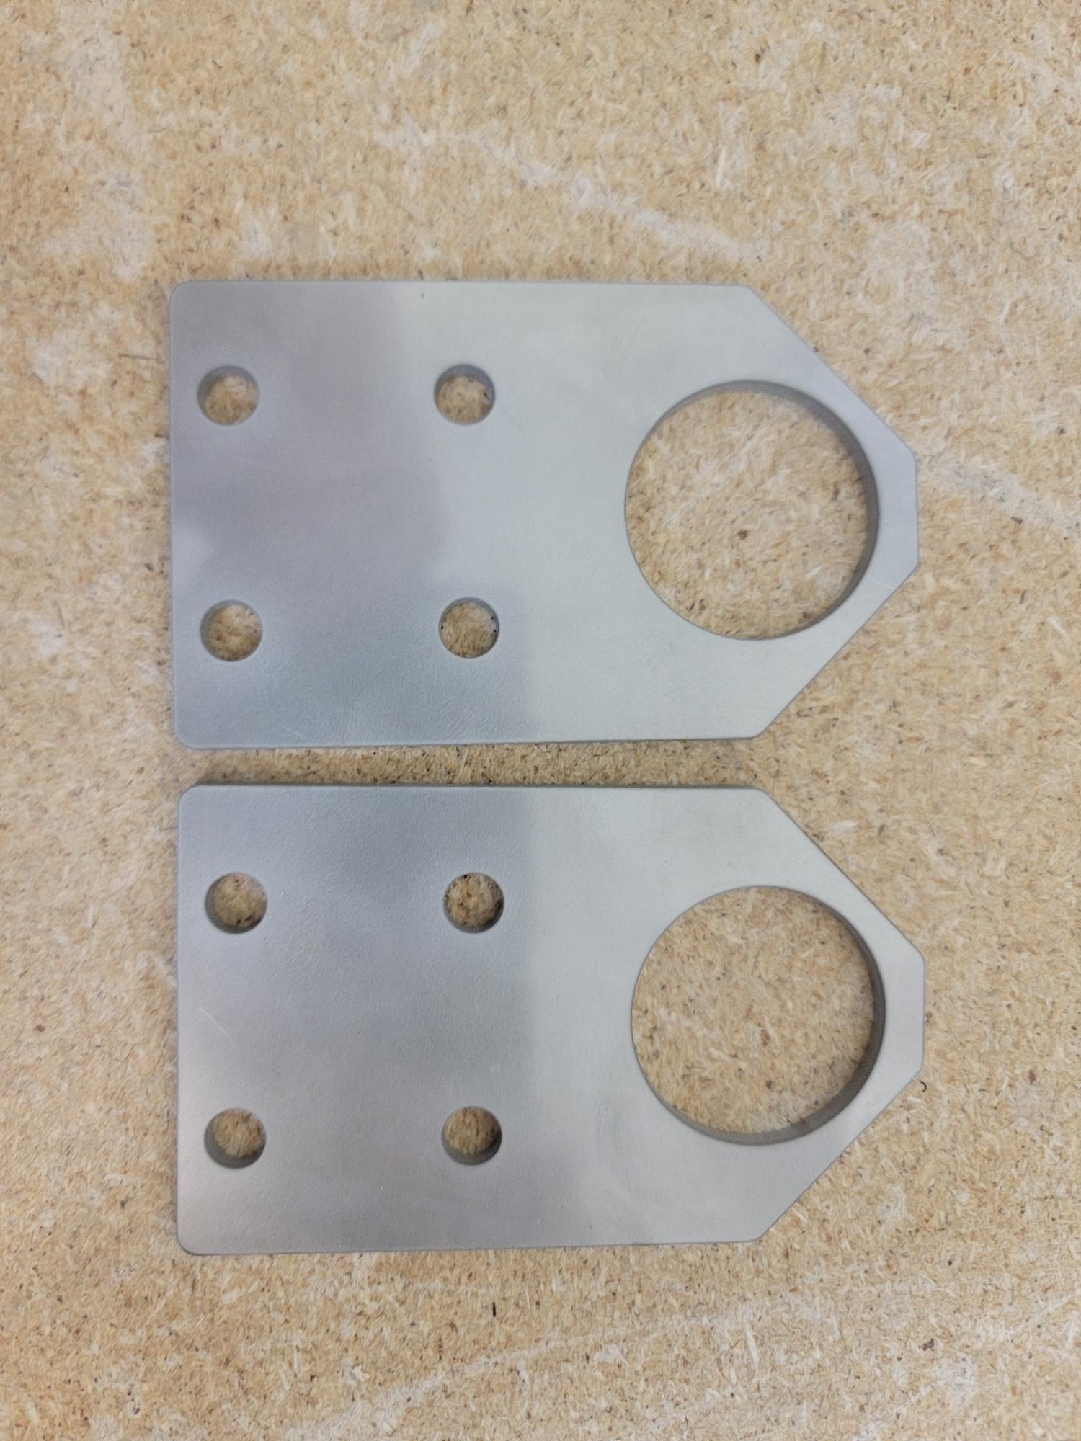
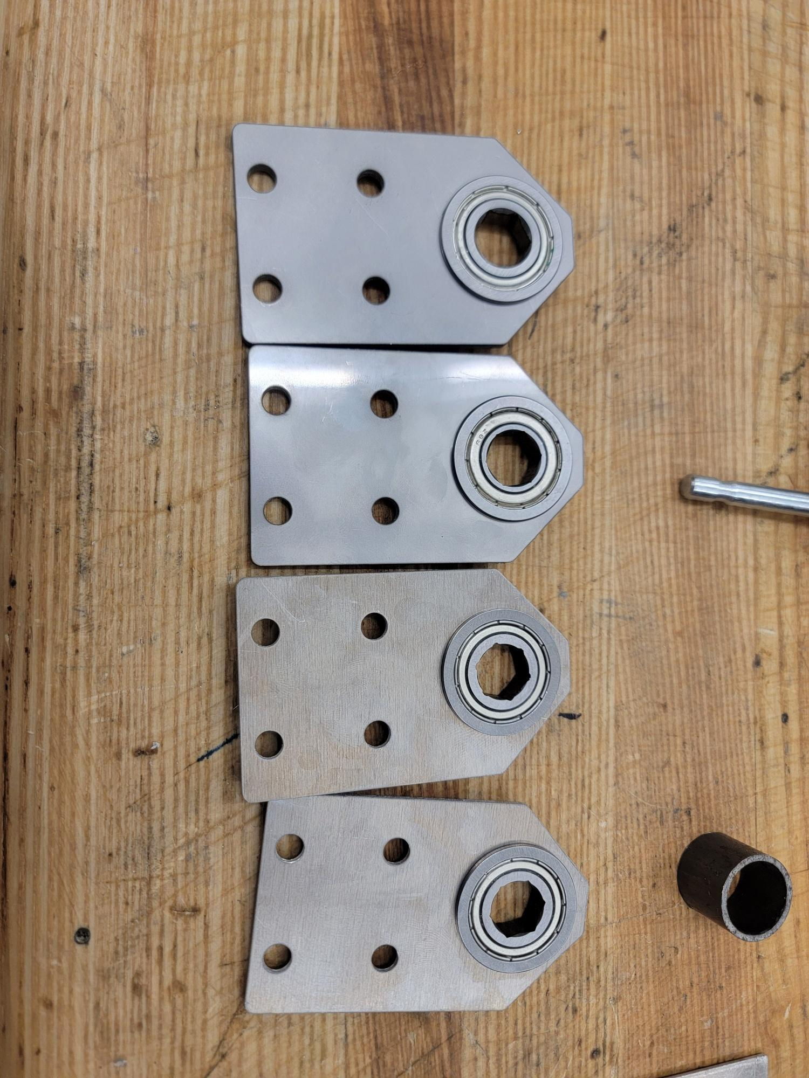
Chassis Development
Wheel brackets
0.12” thick 304 stainless steel sheet
Waterjet cut stock into desired bracket shapes
Mounting holes tapped with ¼”-20 threads
Flanged bearings press fit into brackets with arbor press
Fastened with ¼”-20 screws and t-nuts to slot brackets into slots on chassis
Custom Wheel Bracket
Bearings Pressed In
Smooth Operator
Notes:
Nicholas
made of 0.12” thick 304 stainless steel
Holes cut to accept ¼”-20 screws and bearings
Flange on bearings helps hold them securely on bracket

Slide 12
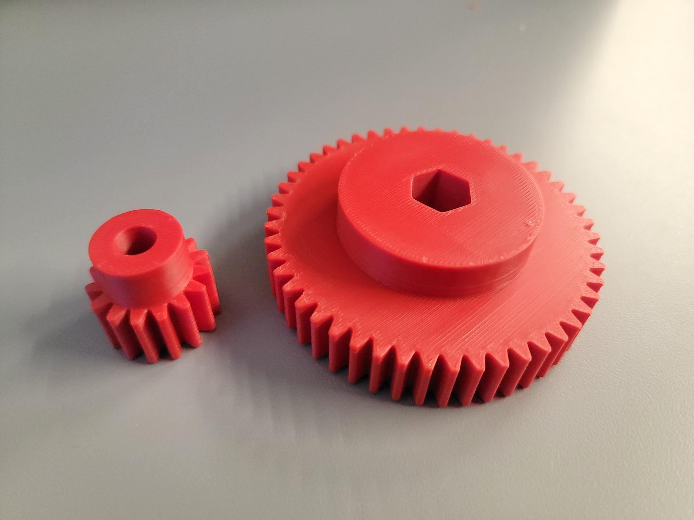
Chassis Development
Drivetrain
Pulleys
15 tooth aluminum driving pulley
45 tooth PLA driven pulley
Mesh with 5mm HTD timing belts
1/2" hex bore
3:1 gear reduction
Gears
15 tooth ABS driving gear
8mm bore
50 tooth ABS driven gear
½” hex bore
10:3 gear reduction
3D Printed Wheel Gear
Smooth Operator
Notes:
Nick
3d printed gears and larger pulleys. smalley pulleys bought. Larger pulley printed at 25% cubic infill with 2 wall loops for 3d isotropy
ABS plastic used for gears due to offering more flexural strength and elongation before failure, making it more ideal for end use like gears. 4 wall loops with 40% gyroid infill for high strength and 3d isotropy
Compound gear reduction to achieve a 10:1 gear reduction. Compound gear reduction was chosen to help reduce the size of the drivetrain and shift the motors further towards the back of the chassis for greater luggage clearance.

Slide 13
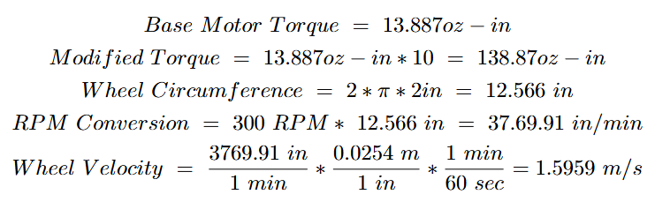
Chassis Development
10:1 Gear Reduction Calculations
10:1 gear reduction is sufficient for our design
Resulting velocity calculated to be slightly higher than desired velocity of 1.4-1.5 m/s
Resulting torque calculated to be slightly lower than necessary torque of 144 oz-in to move at desired velocity with 100lb load.
Smooth Operator
Notes:
MATH
Discuss gear ratio
Found gear ratio to be necessary with current motors to actually allow robot to carry desired loads while significantly reducing the robot’s speed.
1:10 ratio increases torque from 13.887 oz-in to 138.874 oz-in which is close to necessary torque for a 100lb load. Decreases speed from 3000 RPM to 300 RPM which results in a robot speed of 1.5959 m/s

Slide 14
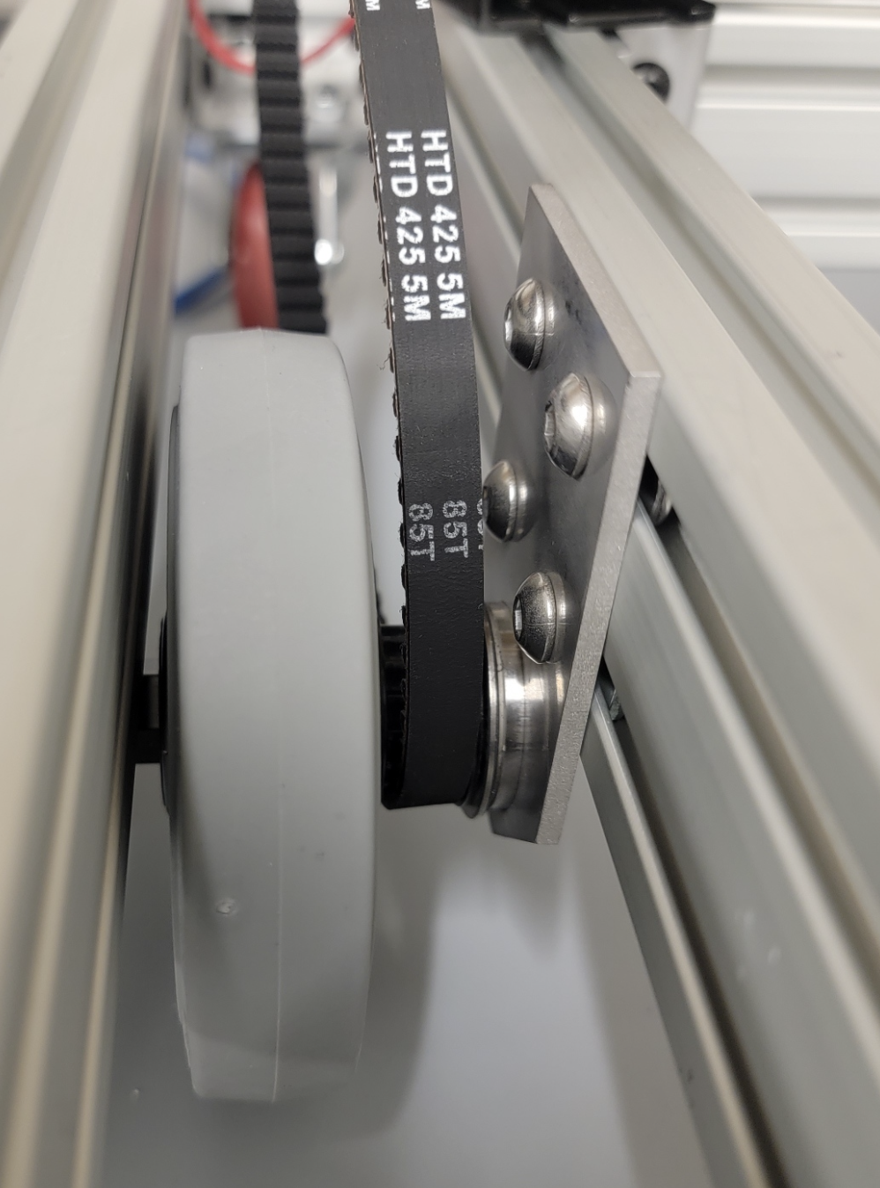
Chassis Development
Drivetrain
Driven wheels
4” diameter Colson Performa wheels mounted at center of drivetrain
½” hex bore
Belt system
85 tooth x 9mm wide 5mm HTD timing belt
½” hex shaft
Flanged bearings
6 mm D to Hex adapter
Clamping shaft collar
Belt System
Smooth Operator
Notes:
Nicholas
Driven wheels mounted at center of drivetrain and connected with ½” hex shaft that runs through the bearings in the wheel brackets. Wheel and pulley secured with hex shaft clamps.
85 tooth timing belt chosen to transmit power to the driven wheels

Slide 15
Next Steps
Chassis
Cut bottom platform upon which luggage is placed
Enclose chassis frame to house electronics and improve chassis visibility
Manufacture motor shrouds to protect against impacts
Smooth Operator
Notes:
Nicholas

Slide 16
Electronic Hardware
SmoothOperator
Notes:
Christian

Slide 17
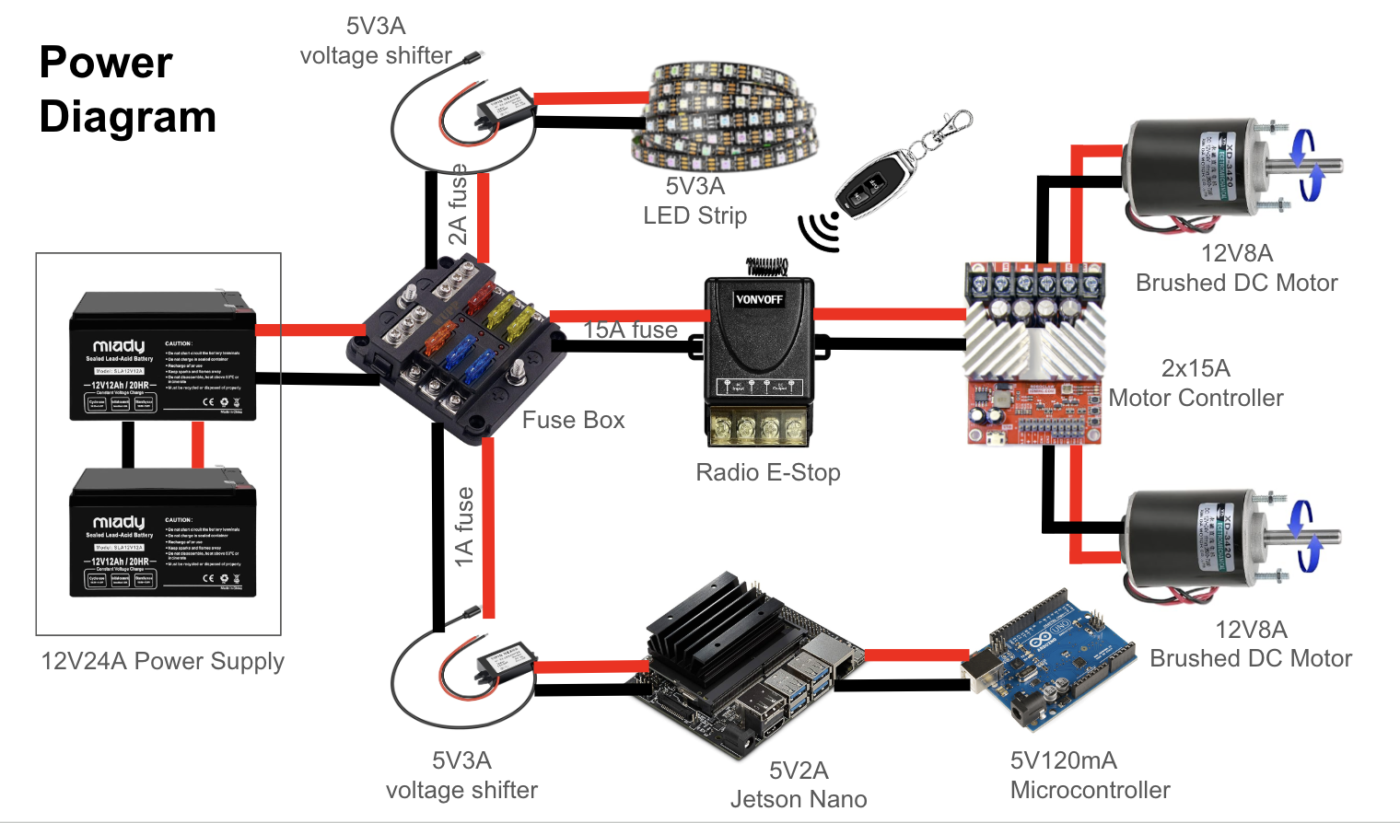
Chassis Electronics
Notes:
Christian
This is the power distribution schematic which is important as we have manyhigh powered actuators
We have put 2 12v 12 A lead acid batteries in paralled for 24A and the additional weight helps the chassis move luggage and not the luggage move the chassis
We have several safety and redundancy practices in place for safety
For example, we have a fuse box to ensure none of the system overdraw current and potentially damage itself
We have an electronic E-stop for emergency shut of the actuators for unexpected behaviour. This is independent from all the other controllers. This only shuts off actuators and not the jetson nano so software is not corrupted.
We also have step down voltage levelers for the LED lights and the jetson nano. These are also attached to the fuse box just in case for any short circuiting may occur.

Slide 18
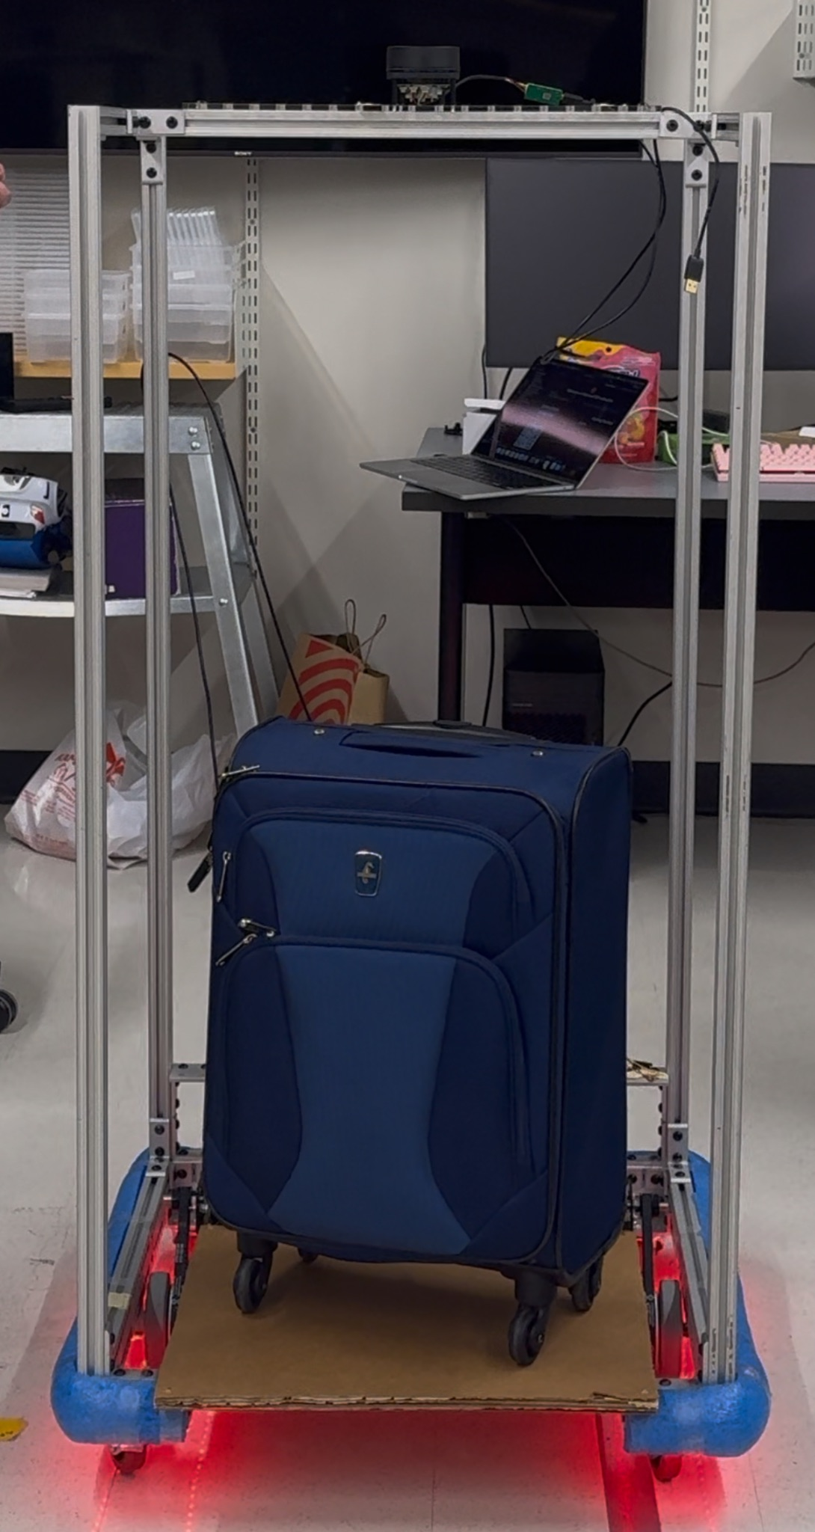
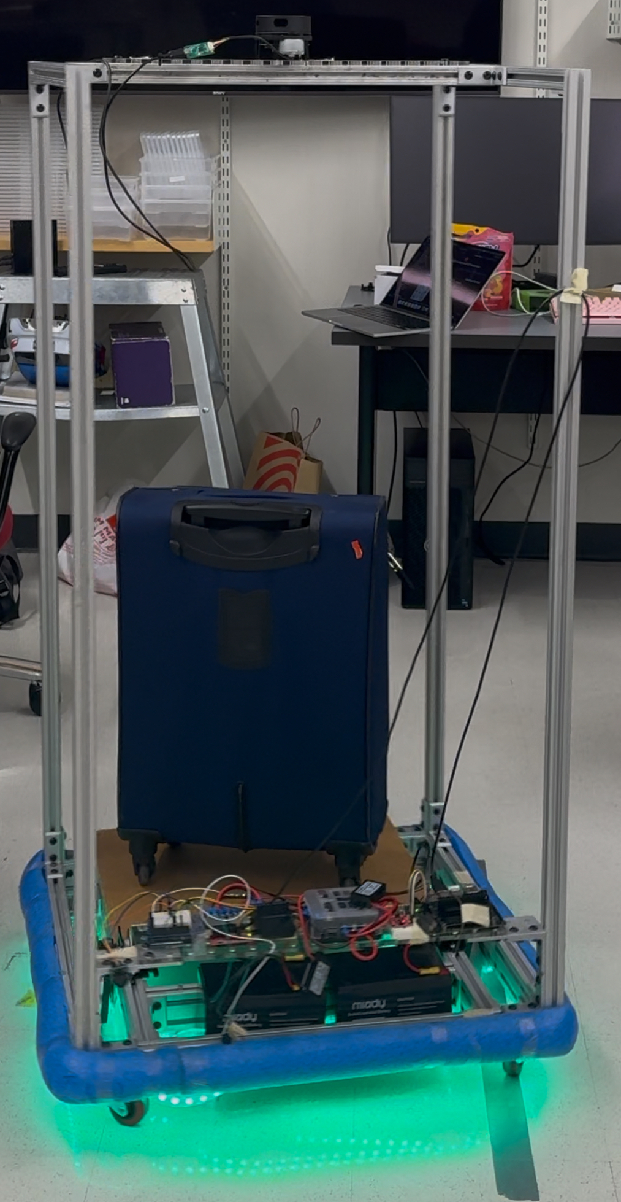
Electronics Design
Customizable electronics plate made from laser cut acrylic
Programmable LED strips for movement indicator (red = stop; green = movement)
LiDAR placed at the top for clear view of the room
Lead-acid battery for heavier chassis (chassis carries the luggage, not the luggage carrying the chassis)
“Stopped”
“Moving”
Smooth Operator
Notes:
Christian
I designed a customizable acrylic laser cut plate for rapid prototyping with electronics
I have also added programmable LED lights under the chassis to give signal indicators for surrounding crowds. Each LED runs at <50mA and we are using 100 LED, leading to about 5V 5A draw
We have also attached the LiDAR at the top of the frame to minimize any obstructions such as the chassis frame.

Slide 19
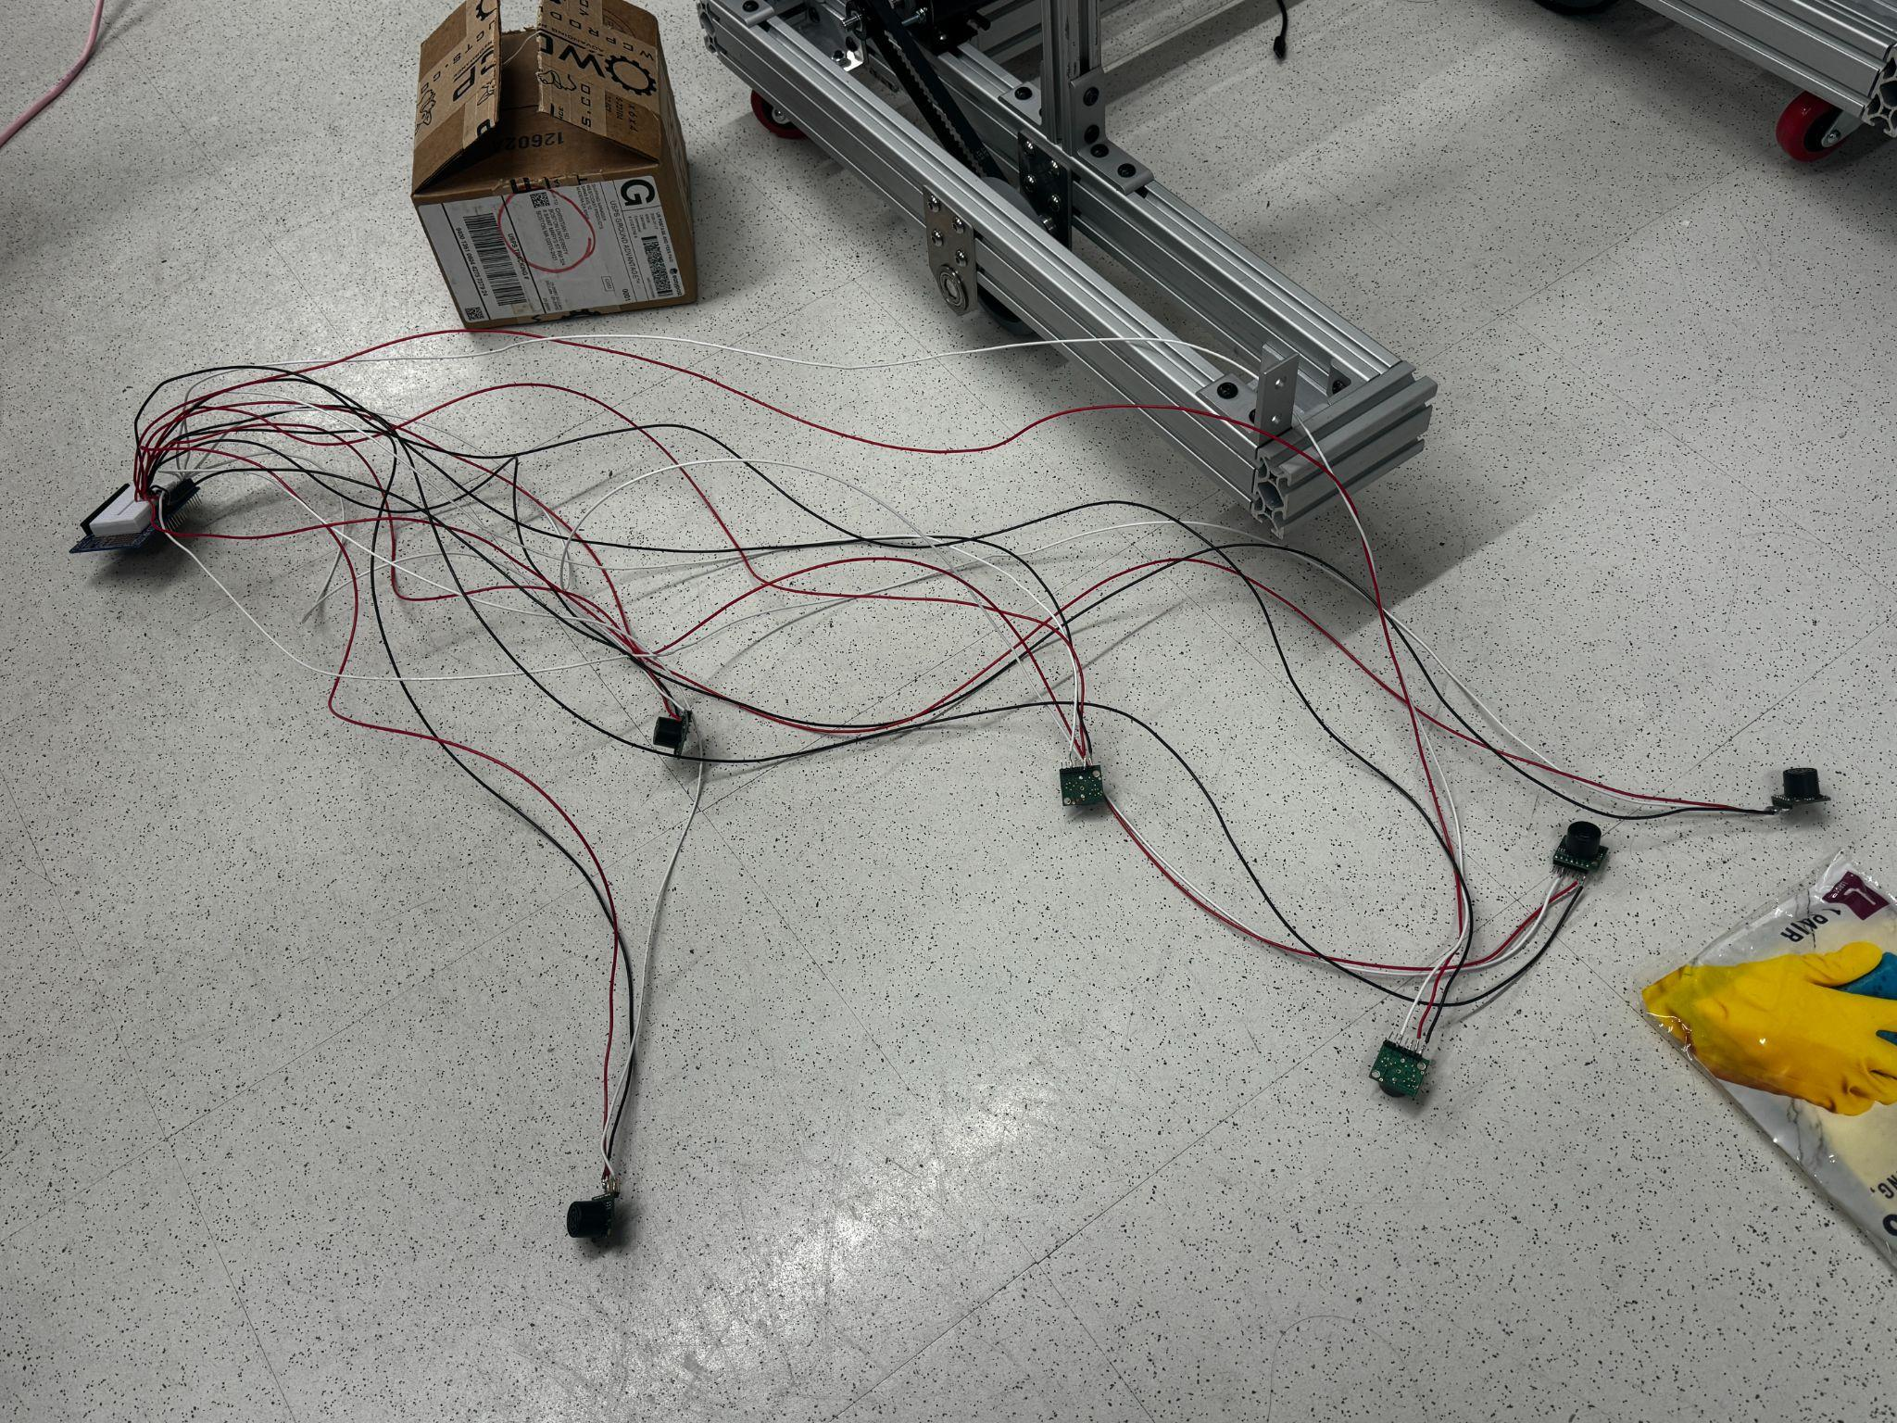
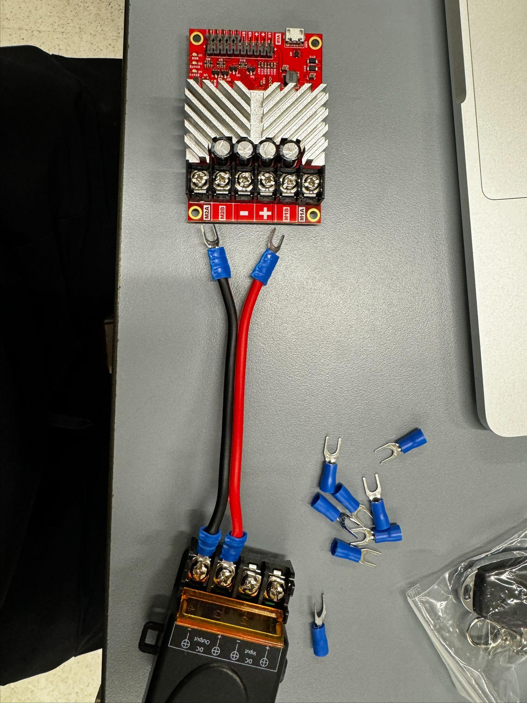
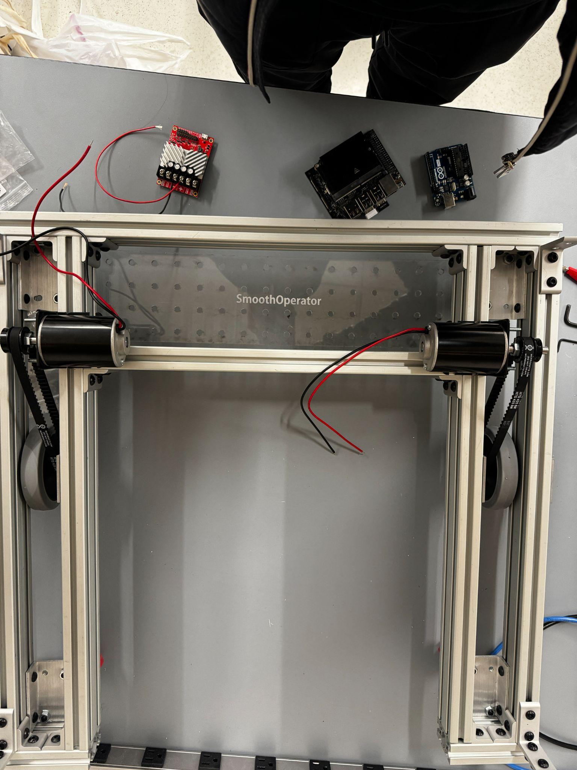
Electronics Implementation
14 AWG used for the motors and power cables (<15A)
22 AWG for signal cables (5V logics 120 mA)
Crimped ends for easy and safe attachment
< 12V 18A, monitored by fuse box
Soldered Ultrasonic Sensors
Smooth Operator
Notes:
Christian
When wiring everything together, I paid close attention to wire gauges for optimal performances of the electronics for safety. So, fo most power cables, I used 14 gauge as no single system draws more than 10A.
We also crimped all our wires for easy replacement and movement of electronics.
To extend the signal of the ultrasonic swensor, we also soldered 22 gauge wire to the sensors so we can easily arrange them on the chassis

Slide 20
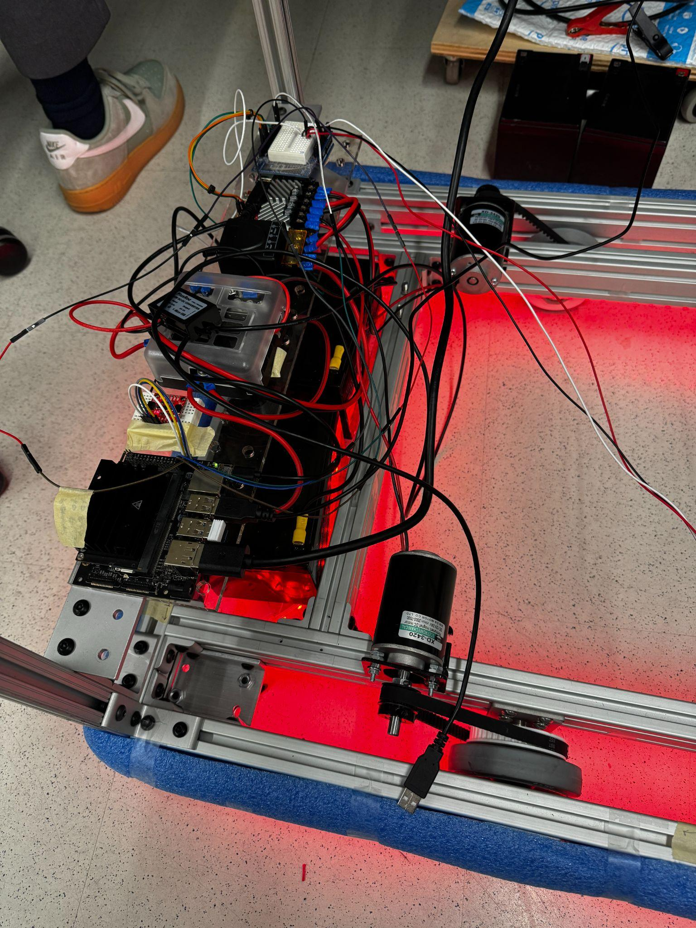
Next Steps
Electronic Hardware
Attach wheel encoders
Add limit switch sensors and floating bumper
Finalize electronic placement and solder pcb board
Organize wires for convenient replacement of parts (screw terminals)
Smooth Operator
Notes:
Christian
This week we plan to add the wheel encoders which will enable feedback controls to the motors and data for odometry which we’ll talk about in a bit
We plan also add limit switch in a form of a floating bumper to add another layer of safety
Lastly, we would like to organize all the wires and solder any final connections.

Slide 21
Network
&
Teleoperated UI
SmoothOperator
Notes:
Eric

Slide 22
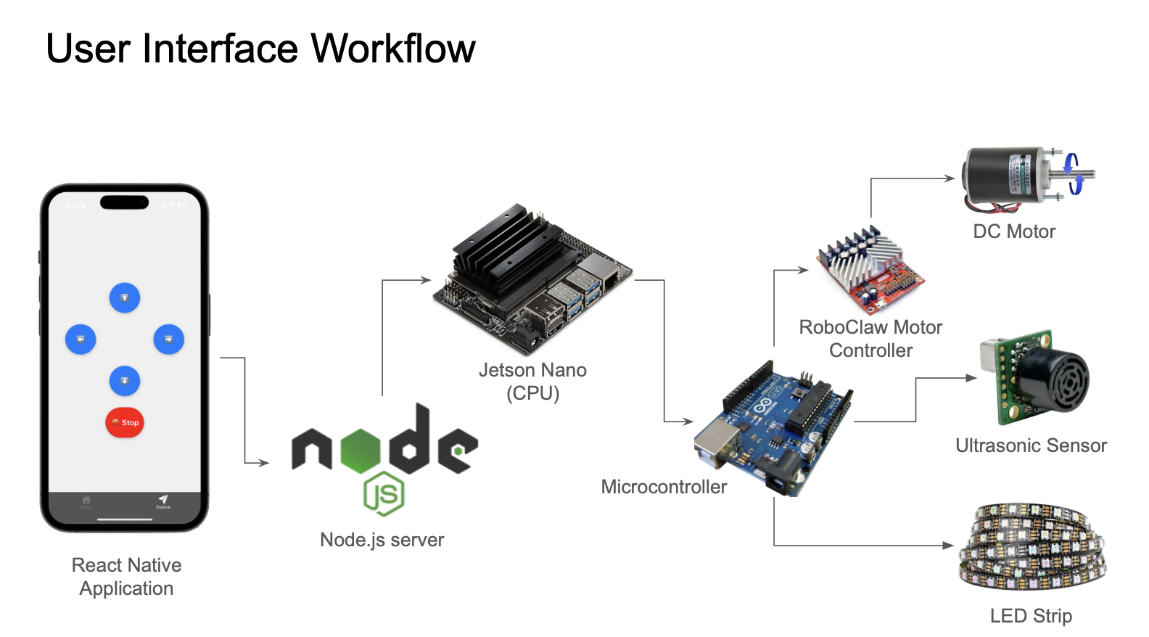
UI System Design
Notes:
Eric
For our system design, we broke it in several components
Starting off with the user application, this is where the user sends commands toSmoothOperator. They can send manual commands or location inputs.
Within the smoothoperator itself, it consist of the hardware: wheels motors and the chassis
A microcontroller specifically a arudino which consist of sensors like utrasonics and rotary encoders. the reason why we choose to use another microcontroller and assign it to these specific sensors were so that there’s no bottlenecks in the
The reason why we have two controllers is because safety is our highest priority. Having two controllers decreases latency delays since we have many different sensor data, algorithms, mapping occurring.
Lastly, we will host a database that will store the different maps of the rooms, airports, and hotel. As well as logs from the different components so developers are able to track the different systems and communications running
The Node.js server is hosted on the Jetson Nano where it can efficiently process commands. Using ‘Express’, we seamlessly handle the HTTP API request commands between the client and robot. The ‘WebSockets’ enable real-time bidirectional communication. For hardware integration, we utilize the SerialPort Library, allowing us to leverage UART serial communication between the Jetson Nano and the microcontroller. The server supports ‘CORS’ or cross-origin requests for external clients. The API endpoints are shown. The arduino endpoint receives the movement commands and sends them to the Arduino. The ros endpoints receives ROS velocity messages from our navigation algorithm.

Slide 23

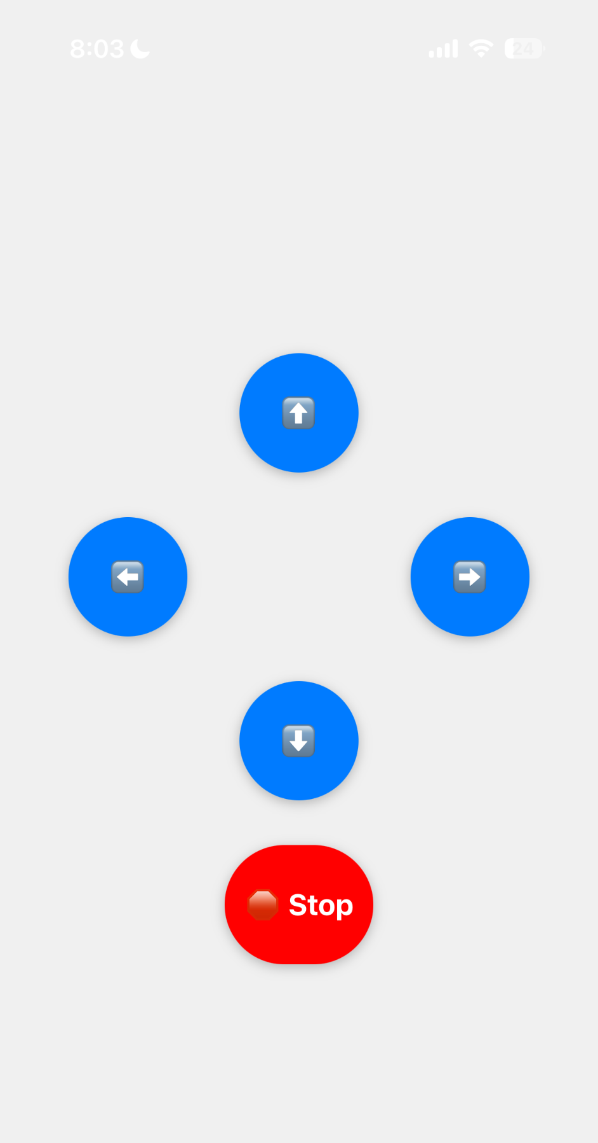
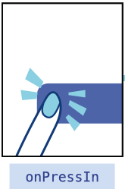
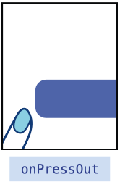
User Interface
Connects to SmoothOperator Robot through subnet
Sends forward, backward, left, and right commands
Momentary Switches (non-latching) commands being sent
‘Pressable ‘wraps any child component & detects various stages of press interactions
Leverages API calls through the Node.js server to send and receive commands
Users can connect with any personal device
Manual Control UI
Pressable (Core Component) in React Native
Smooth Operator
Notes:
Christian
As for the user interface of SmoothOperator. The robot connects to our UI through a subnet, allowing us to send forward, backward, left, and right commands.
These movement commands are encoded using WASD characters and sent through a Node.js server, which acts as a middleman and relays commands to the robot.
One key feature to note is that these buttons function as momentary switches, meaning they are non-latching. This means that when you press and hold a movement button, the robot will move, but as soon as you release it, the robot stops.
To enhance safety, we’ve also added a red stop button in case the robot moves unexpectedly.
To handle these interactions, we leverage React Native’s Pressable component, which wraps each button and detects different stages of a press, ensuring a smooth and responsive user experience.

Slide 24
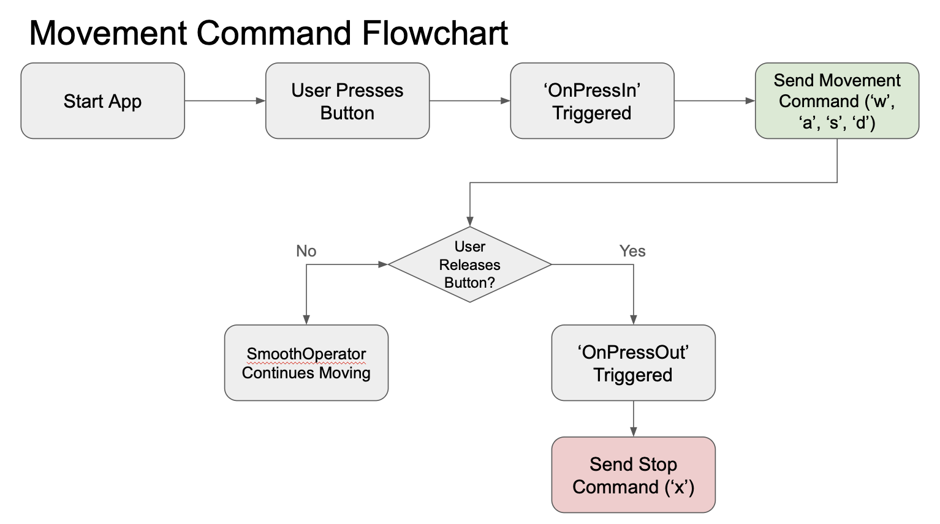
UI System Design
Notes:
Christian

Slide 25
UI System Design
Non-Latching
Notes:
Christian

Slide 26
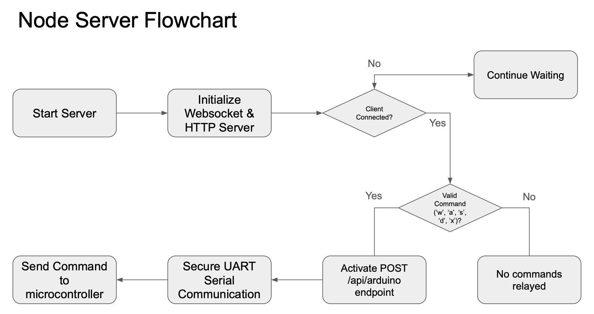
UI System Design
Notes:
Christian
The Node.js server is hosted on the Jetson Nano where it can efficiently process commands.
Using ‘Express’, we seamlessly handle the HTTP API request commands between the client and robot.
The ‘WebSockets’ enable real-time bidirectional communication.
For hardware integration, we utilize the SerialPort Library, allowing us to leverage UART serial communication between the Jetson Nano and the microcontroller.
The server supports ‘CORS’ or cross-origin requests for external clients. The API endpoints are shown.
The arduino endpoint receives the movement commands and sends them to the Arduino. The ros endpoints receives ROS velocity messages from our navigation algorithm.

Slide 27

Next Steps
User Interface
Implement login and device pairing features to improve security
Improve accessibility of app aesthetics
Color scheme to accommodate color-blindness
Size of buttons for easier selection
Smooth Operator
Notes:
Christian
For the next steps of the UI, we will be focusing on user-centric features such as a login and device pairing page. We will also make strides in the general aesthetic of the application.

Slide 28
Mapping & Navigation
SmoothOperator
Notes:
Eric

Slide 29
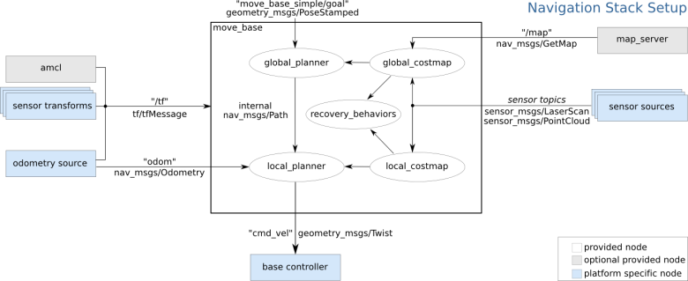
Mapping and Navigation Design
Notes:
Eric
This is a high-level overview of all the required nodes for our entire navigation stack. The outside boxes all feed important data like laser scans, odometry, transformations, and map of the environment to the move_base node which has all the navigation algorithms, costmaps, and recovery behaviors. The move_base node will produce a velocity message to tell the motors how fast to move and in what direction.

Slide 30
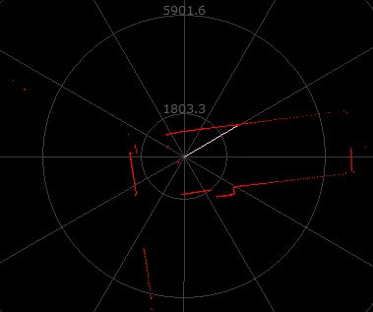
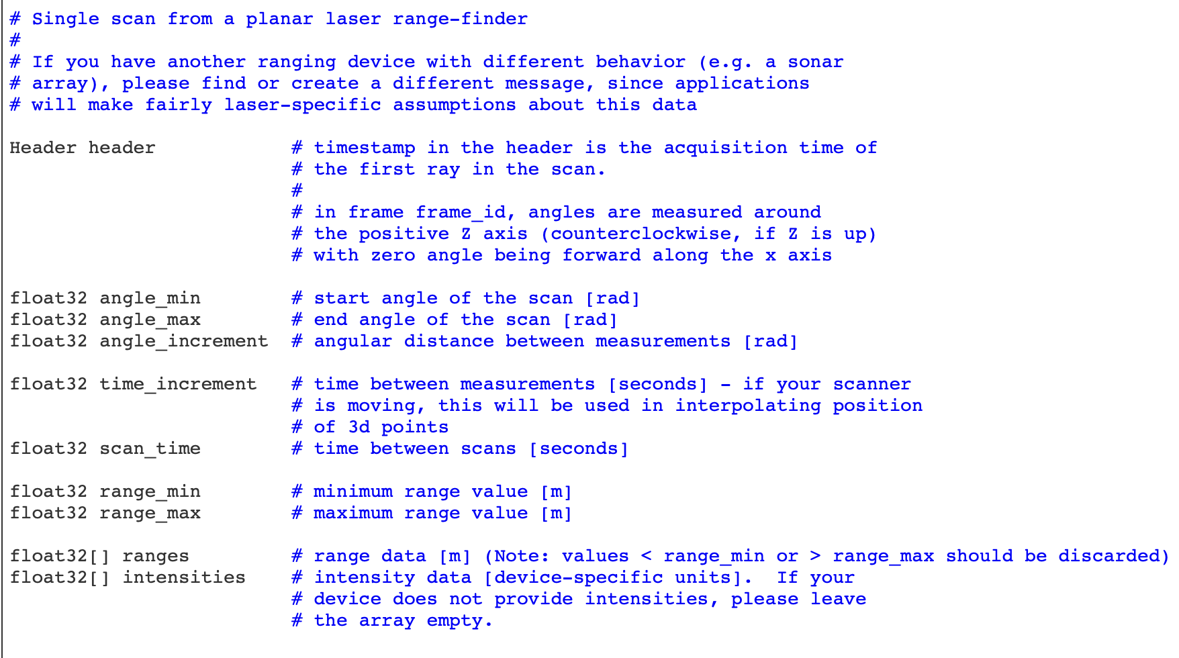
Sensor Sources Node
Reads raw 360 degree scans from the RPLidar A1M8 and converts it to a ROS LaserScan message
Publishes the messages to a topic (communication channel) called /scan -> used by the mapping server and obstacle avoidance algorithms
LaserScan messages hold data such as: an array of range readings, starting and ending angles, time between scans, etc…
Smooth Operator
Notes:
Eric
Now, going into more detail for each node within the diagram. The first one is the sensor source node which can be thought of as the eyes of the robot. The LiDAR continuously scans more than 8000 times per second and the node retrieves the data and organizes it into a ROS LaserScan message for easier processing. These new messages are published to a topic called /scan where it will later be used by other nodes such as the mapping server and obstacle avoidance algorithms. This image here shows a sample of the lidar scanning a room and this image shows the contents of the LaserScan message which includes data such as: an array of range readings, starting and ending angles, time between scans, etc

Slide 31
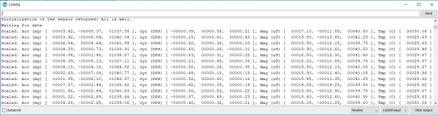
Odometry Publisher Node
Odometry publisher node retrieves accelerometer and gyroscope data from ICM-20948 IMU and organizes it into a geometry_msgs/Accel message
Contains linear acceleration in 3 axes and angular velocity in 3 axes
Only need linear acceleration in the X, Y axes and angular velocity in Z axis
Responsible for tracking the change in position over time
Smooth Operator
Notes:
Eric
The odometry publisher node retrieves both accelerometer and gyroscope data from our IMU and organizes the data into an acceleration message. The message contains important information like linear acceleration and angular velocity. The main components that we are focused on are linear acceleration in the X, Y axes and the angular velocity on the z axis since those will allow our robot to move anywhere on the 2d plane. The main responsibility of the IMU is to provide information such that we can track the change in position of our robot over time

Slide 32
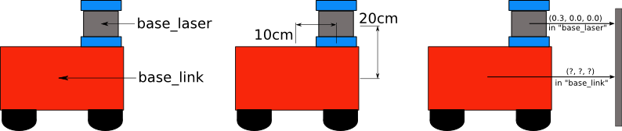
Sensor Transforms Nodes
Static transforms to convert between coordinate frames of the robot
Base_link -> origin of the mobile base of SmoothOperator
Base_laser -> origin of the LiDAR
Odom -> origin of the IMU
Helps translate data from the perspective of the data sources to the robot’s base
130cm
Smooth Operator
Notes:
Eric
The sensor transform nodes are responsible for converting between coordinate frames of the robot. Base_link refers to the origin of the mobile base of SmoothOperator, base_laser is the origin of the LiDAR, and odom is the origin of the IMU. This node is important because it helps translate data from each data source to the robot’s base. The robot does not care about what sensors are reading if it does not know where the reading is coming from. In the image you can see a laser mounted on top of a simple robot. All of the laser readings are translated to the reference frame of the robot, so the robot knows how far it is from that reading.

Slide 33
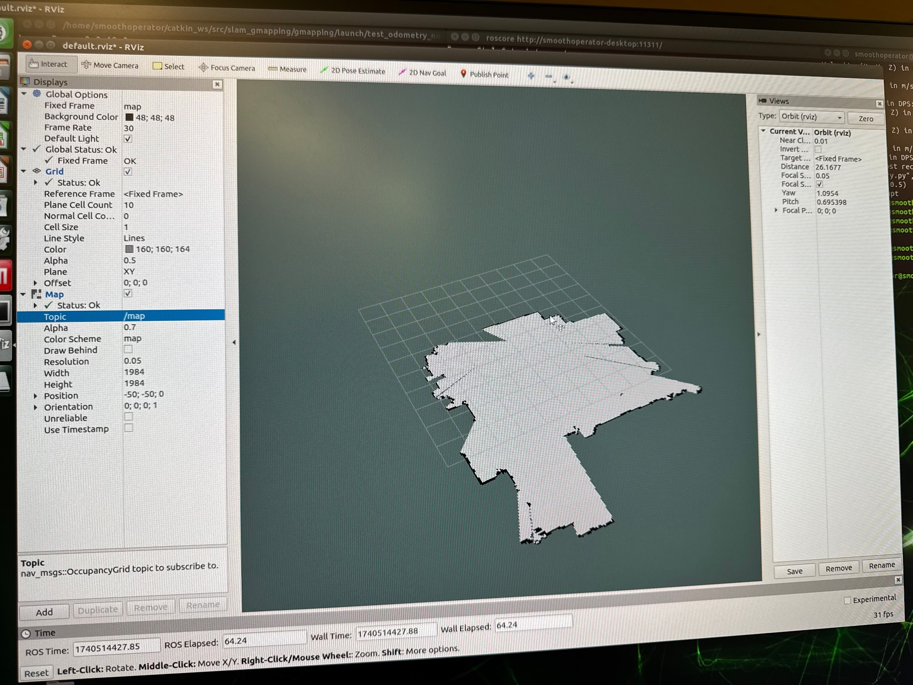
Map Server
Responsible for creating a static map of the environment
Represents the valid boundaries that the robot can traverse
Subscribes to the /scan topic from the sensor source node and static transforms to publish data to the /map topic using nav_msgs/OccupancyGrid message type
Uses particle filter where each particle carries an individual map of the environment
Tracks multiple possible robot positions and updates their weights based on how well they match sensor readings
Smooth Operator
Notes:
Eric
The map server node is responsible for creating the static map of the environment. It creates the map by subscribing to the /scan topic, static transforms, and odometry topic. The algorithm uses a particle filter where each particle carries an individual map of the environment. It will track multiple possible positions and updates their weights based on how well they match sensor readings.

Slide 34
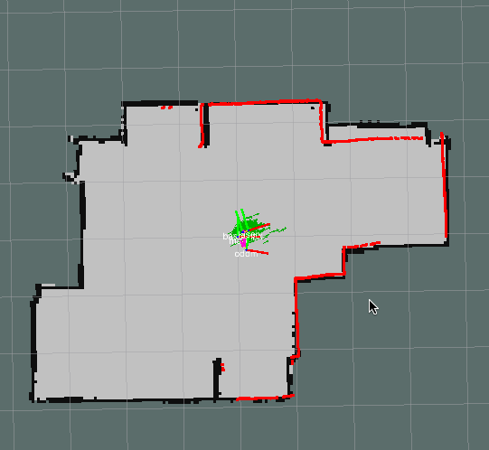
Robot Localization
Uses AMCL which is a probabilistic localization system for a robot moving in 2D
Implements the Monte Carlo localization approach, which uses a particle filter to track the pose of a robot against a known map
Subscribes to the /scan topic, static transforms, and /map topic created by the map server
Smooth Operator
Notes:
Eric
Notice the arrows representing the particle cloud (guesses to the pose of the robot) converging as the system receives more data

Slide 35
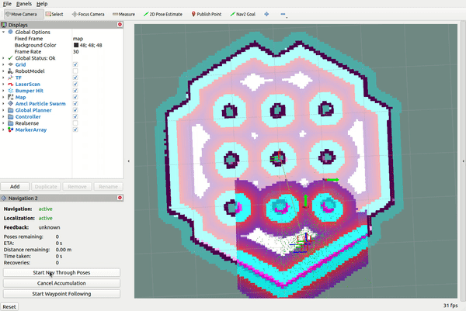
Costmaps
2D grid representations of the environment used to plan safe paths for SmoothOperator
Broken down into global costmap and local costmap
Global costmap is used for long-term path planning (end-to-end)
Local costmap is used for short-term obstacle avoidance
Smooth Operator
Notes:
Eric
Higher values mean lethal obstacle and lower values mean safe to navigate

Slide 36
Move_Base
Core path planning and navigation node
Uses a global planner, local planner, and costmaps to publish geometry_msgs/Twist messages to the /cmd_vel topic
Contains information like how fast to drive and in what direction
Global planner manages end-to-end path planning
NavfnROS is based off Dijkstra’s algorithm and uses the map to create a grid representation to find the shortest path
Local planner manages obstacle avoidance and real-time motion control
DWA (dynamic window approach) evaluates possible velocities in a local window before picking the best one
Smooth Operator
Notes:
Eric
Is there a visual for this?
Higher values mean lethal obstacle and lower values mean safe to navigate

Slide 37
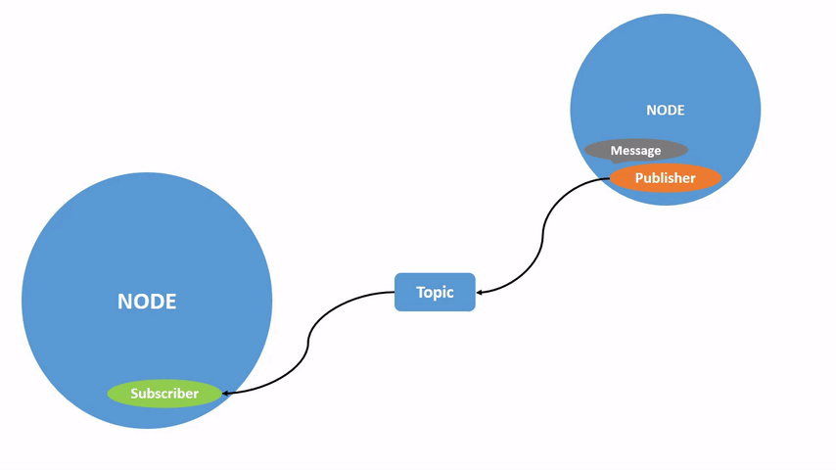
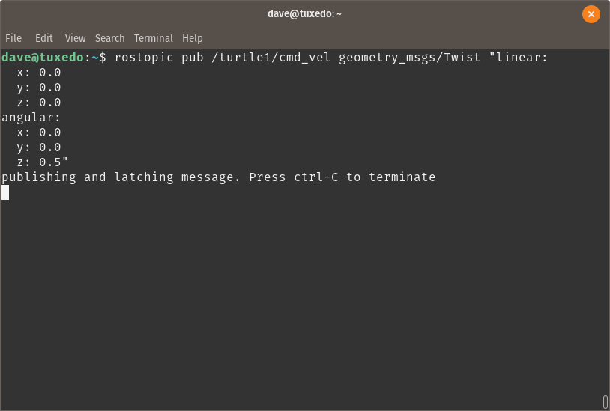
Base Controller
Subscribes to the /cmd_vel topic, connects to the Node.js server, and sends the velocity message
Offloads all motor controls to the Node.js server
Separates responsibility between the server who communicates with the motors vs the navigation stack that simply produces the direction and speed for the mobile base to follow
move_base
base controller
cmd_velocity
Smooth Operator
Notes:
Eric
Annotate this picture

Slide 38
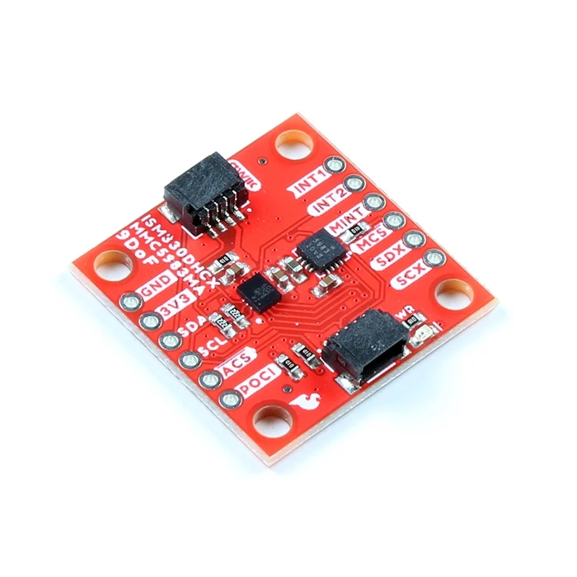
Next Steps
Mapping and Navigation
Fix obstacle layer and inflation layer, so that it appears on visualization tool
Converting /cmd_vel messages to a proper motor speed/direction to move SmoothOperator
Use wheel encoders for more precise measurement of position and sensor fuse data with IMU
Set criterias for what dictates “good” performance
Tune parameters of the entire stack to achieve optimal performance
Smooth Operator
Notes:
Eric

Slide 39
Safety Design
SmoothOperator
Notes:
Christian

Slide 40
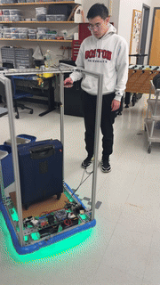
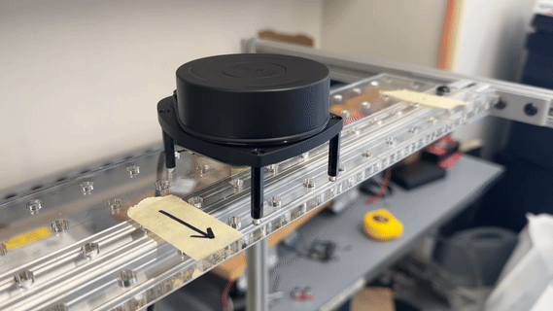
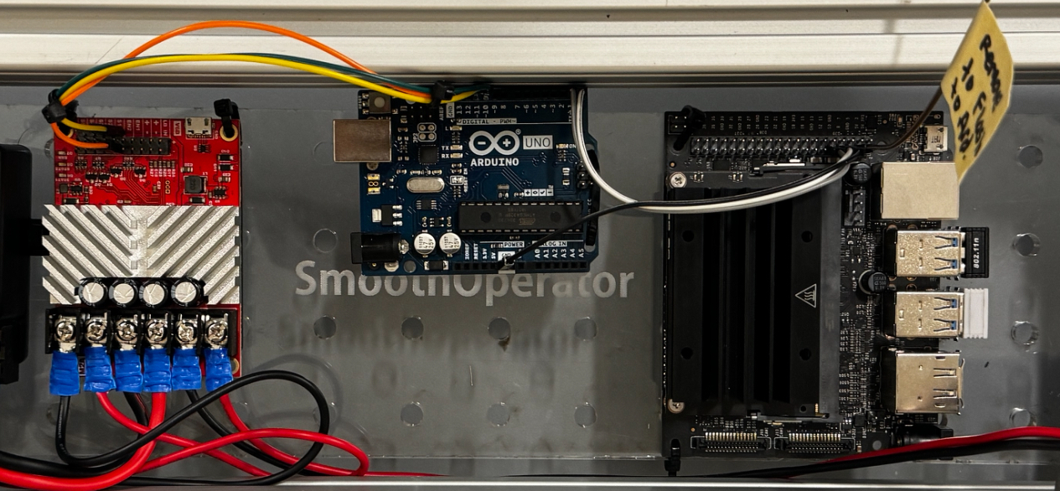
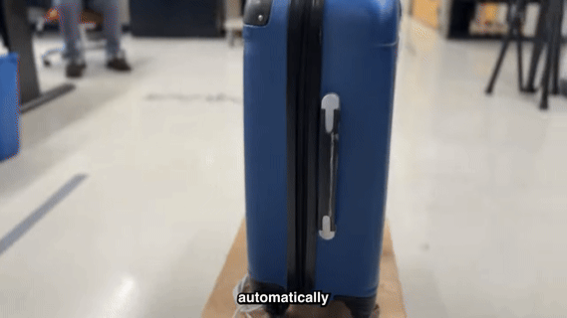
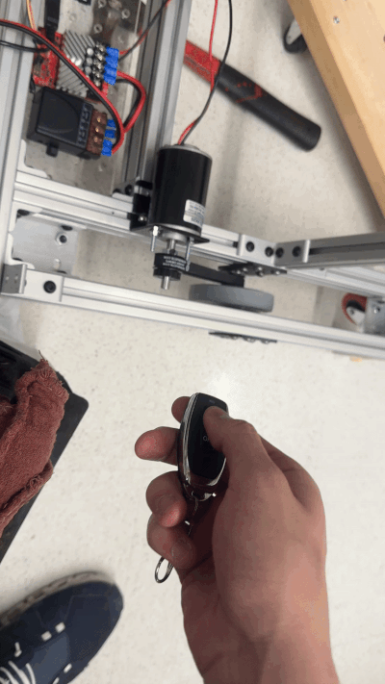
Safety Design
5
LED Indicators, Noise/Talking, Animated Eye
LiDAR Navigation & Obstacle Detection
4
CRITICAL
(least to most)
Redundant Hardware Controllers
3
Ultrasonic Sensor,
Limit Switch
Floating Bumpers
2
E-Stops/Radio E-Stop,
Fuse Box
1
Notes:
Christian
The reason why we have two controllers is because safety is our highest priority. Having two controllers decreases latency delays since we have many different sensor data, algorithms, mapping occurring.
Lastly, we will host a database that will store the different maps of the rooms, airports, and hotel. As well as logs from the different components so developers are able to track the different systems and communications running

Slide 41
Project Management
SmoothOperator
Notes:
Christian

Slide 42
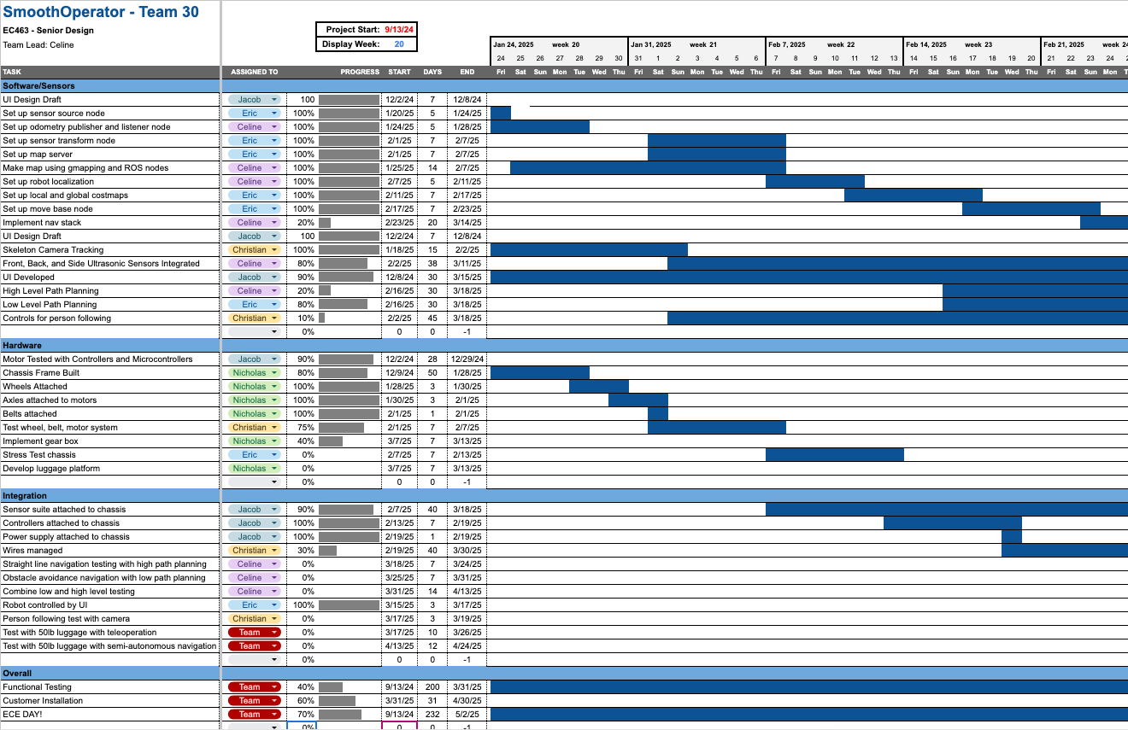
Gantt Chart
Project Management
Click Image to go to Full Gantt Chart
Smooth Operator
Notes:
Christian

Slide 43
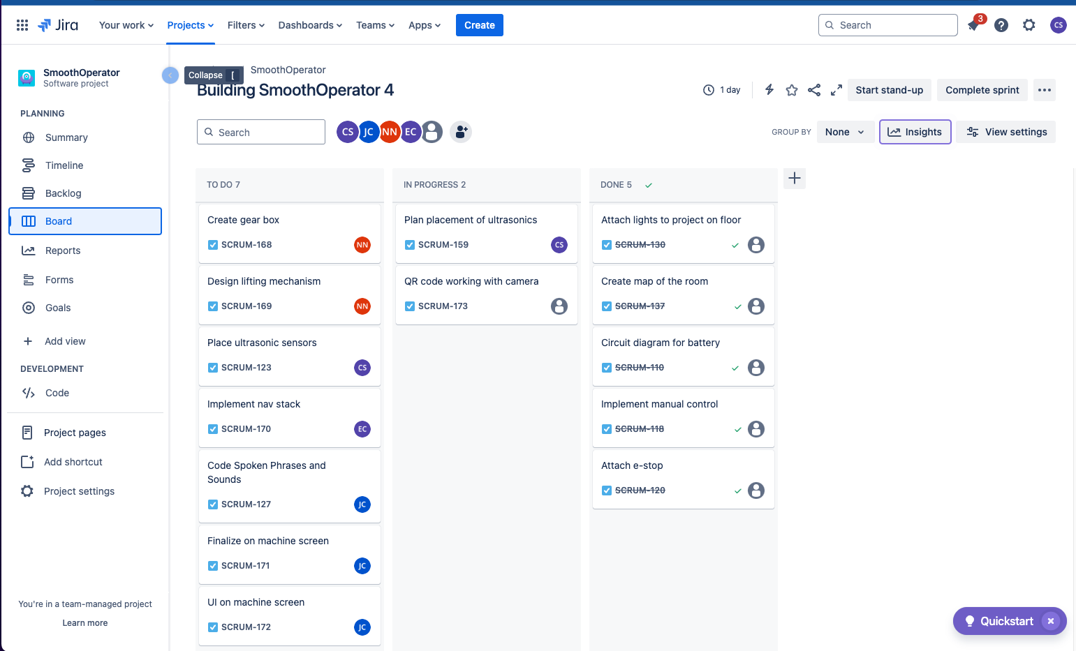
JIRA Board (Agile Management)
Project Management
Smooth Operator
Notes:
Christian

Slide 44
Thank You
Questions/Comments?
SmoothOperator
Notes:
Christian

Slide 45
Odometry Listener Node
Odometry listener node subscribes to the topic that the odometry publisher sends data to (/imu/data)
Filters noisy data to ensure the robot does not think it has moved if the accelerometer reads low readings
Publishes to the /odom topic with message type nav_msgs/Odometry
Used by the move_base controller (localization, costmaps, navigation, etc…)
Smooth Operator
Notes:
Eric
As the odometry publisher node is sending information into one of the communication channels, the odometry listener subscribes to that topic and retrieves the data. This node has one responsibility which is filtering noisy data to ensure the robot does not receive misguided information about where it has traveled. If the IMU data is poor, the robot localization node will perform poorly which will accumulate errors over time. After cleaning up the data, it publishes it to the /odom topic using the odometry message type.

Slide 46


User Interface
React Native Application
Allows for cross-platform compatibility
Users can connect with any personal device
Expo app used for prototyping
React Native
Expo
Smooth Operator
Notes:
Eric
Now, let’s talk about the user interface for SmoothOperator™. We chose React Native as our framework for building the UI on users' personal devices. The main reason for this choice is cross-platform compatibility, which allows us to develop for web, Android, and iOS simultaneously. This parallel development ensures that users can connect to our robot seamlessly, whether they’re using a phone, tablet, or laptop.
For prototyping, we’re leveraging the Expo app, which makes testing more efficient. By scanning a QR code generated from the command line, we can quickly preview and refine the interface directly on a mobile screen, streamlining development and iteration

Slide 47
Node.js Server
Hosted on the Jetson Nano
Express: Handles HTTP API requests.
WebSockets: Enables real-time bidirectional communication
SerialPort: Manages UART serial communication with Arduino
CORS: Allows cross-origin requests for external clients
POST /api/arduino: Accepts movement commands (w, a, s, d, x) and sends them to the Arduino
POST /api/ros: Receives ROS velocity messages (vx, vy, vtheta)
Smooth Operator
Notes:
Christian
Imrpove presentation
The Node.js server is hosted on the Jetson Nano where it can efficiently process commands. Using ‘Express’, we seamlessly handle the HTTP API request commands between the client and robot. The ‘WebSockets’ enable real-time bidirectional communication. For hardware integration, we utilize the SerialPort Library, allowing us to leverage UART serial communication between the Jetson Nano and the microcontroller. The server supports ‘CORS’ or cross-origin requests for external clients. The API endpoints are shown. The arduino endpoint receives the movement commands and sends them to the Arduino. The ros endpoints receives ROS velocity messages from our navigation algorithm.

